Slide 1
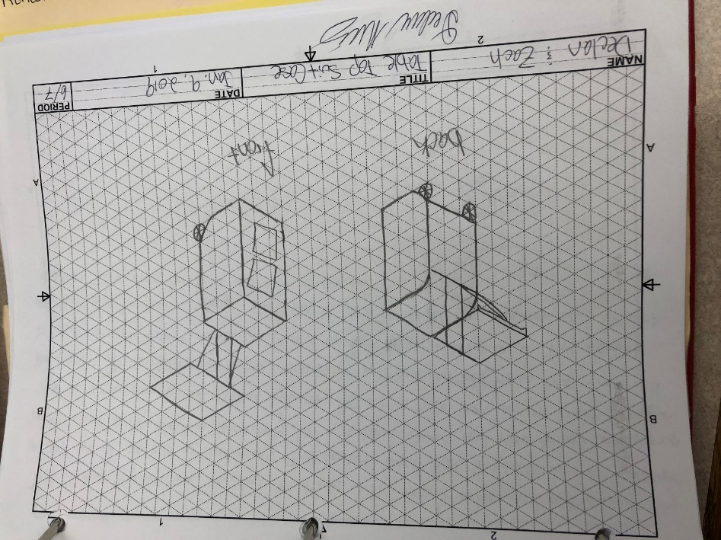
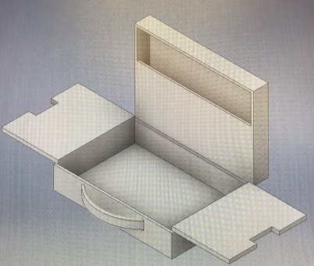
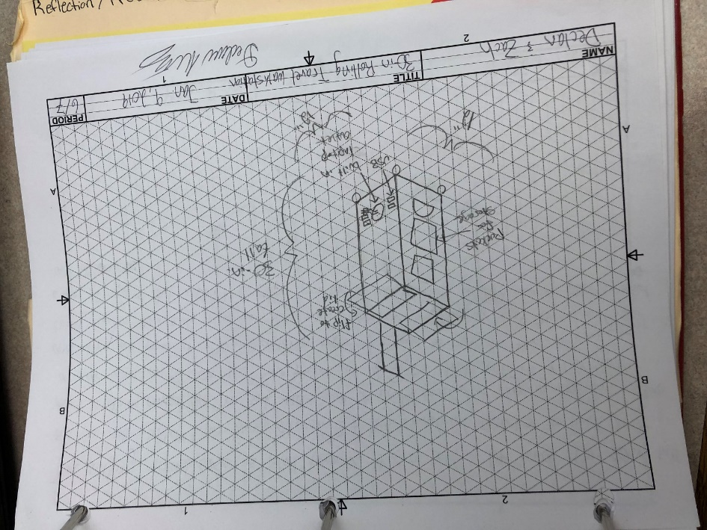
This table top suitcase is ideal for those who travel a lot and are constantly in and out of airports or conventions. This product would have 2 wheels and a telescope handle that would function identically like a suitcase. However, upon time to set up a pop-up shop or are waiting for an airplane, you can flip out the table that adjusts height based on the height of the telescope handle. This table will have an additional bar that will be used to apply support so you can place a notebook, tablet, or laptop on top. This product will have dual functioning storage that can be used for travel necessities and for work supplies. This would/could be applicable to anyone.
This briefcase takes the traditional briefcase to a whole new level. This briefcase will have a compartment on the top flap for smaller items like paper, tablets, folders, pencils, pens, etc. In order to access the lower half you must lift the two flaps. These flaps act as a portable working surface for writing notes or using a mouse for a laptop/tablet. By opening the flaps it will pull up on the lower platform where a laptop or tablet can be stored. This lower platform will rise vertically upon the flaps opening that way the laptop/tablet will be readily available. This will make working on the go more efficient and can be used by anyone.
The rolling travel case is ideal because it can hold a lot since it is 30 inches tall and can roll rather than being carried. It has standard pockets to hold just about anything needed. On the side there will be USB ports and plug in for laptop or other large devices. On the top there are 2 flaps that act as a lid and once they are opened it acts as a table top. This would be ideal for teachers mostly to carry supplies from home to school, but also double as a podium up front. This would hold a lot of supplies but wouldn’t be super portable or convenient to continuously place in and out of vehicles.
Problem Statement:
Office Space costs a lot, as little as $1.74/sq ft in Atlanta to as much as $6.16/sq ft. in Los Angeles. This is why ¾ of the population will be working remotely by 2020. Since 40% of people check their email at least 5 times a day outside of the house or office and with office space being so expensive; business men/women, teachers, entrepreneurs, salesman, etc. are looking for efficient ways to “work on the go."

Slide 2
End Users + Experts
Consultants:
  C.F. Roark LLC
  Eli Lilly
  IPS School System
  Diebold Nixdorf
  Habitat for Humanity
Consumers:
  Teachers
  Businessmen/women
  Students

