Slide 1
Identifying Subsystems and Incremental Testing Opportunities
Declan Ruiz & Zach Shellhorn

Slide 2

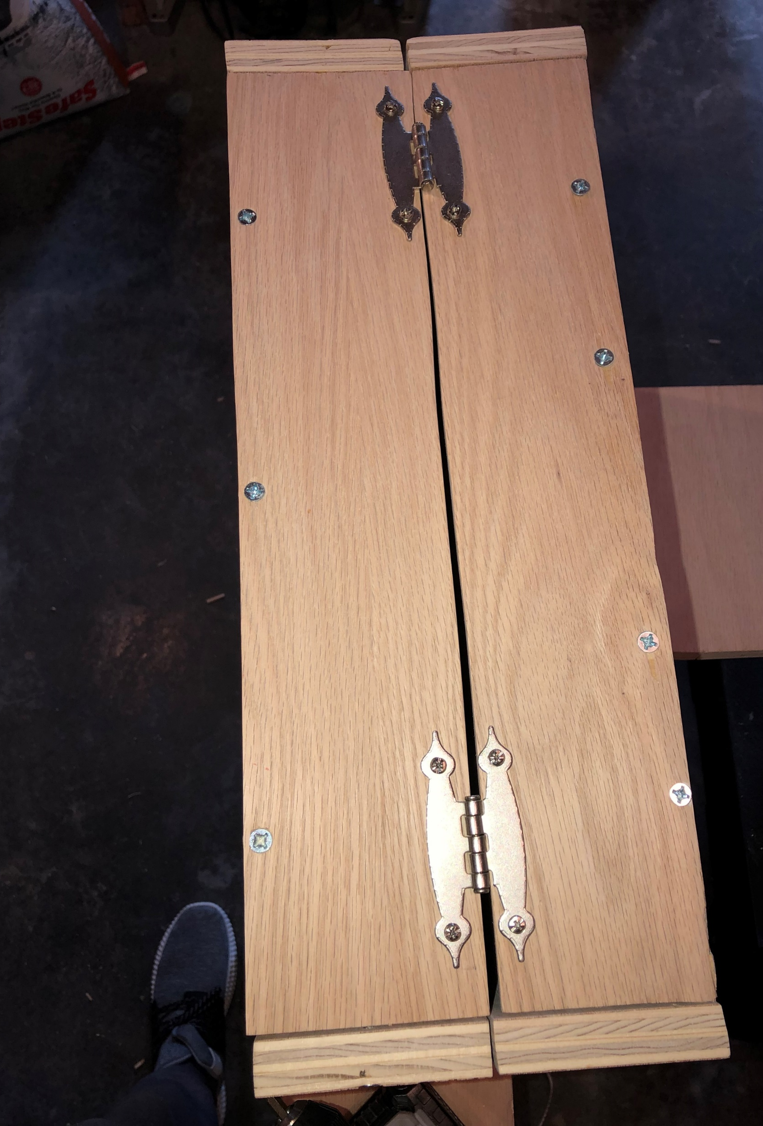

Hinges:
The hinges function by keeping the top and bottom half connected while still being able to open and close. This allows a fluid motion of opening and closing without any effort.
We can test to make sure the hinges work properly by opening and closing the lid to see if the two parts stay attached.
If we can open and close the lid with no friction and with a fluid motion without the lid/bottom detaching then we know that hinges worked.
If we can do this consistently then we can call this a success.

Slide 3
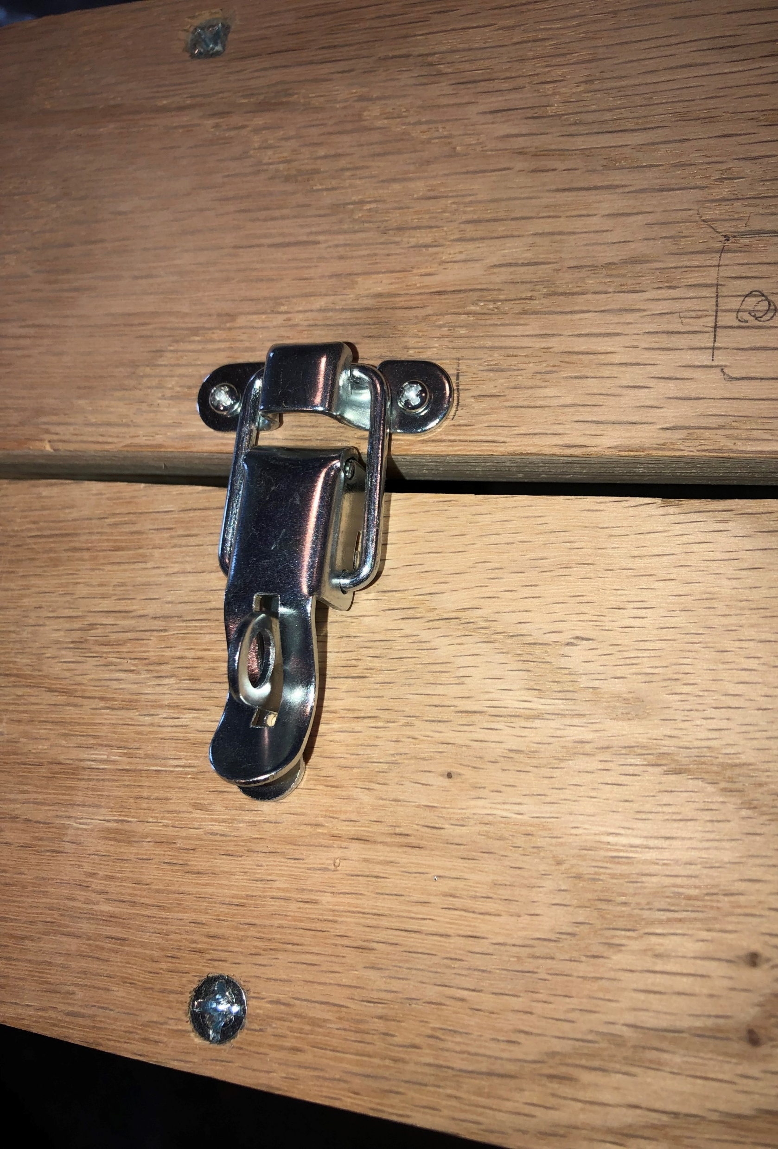
Latches:
The two latches are used to lock the top and the bottom together so they don’t fly open. This is important so all your important items don’t go flying everywhere.
We can test the latches by opening and closing them repeatedly until they no longer work.
The latches will be considered functional as long as they catch onto the top piece and keep the two parts (top & bottom) connected.

Slide 4
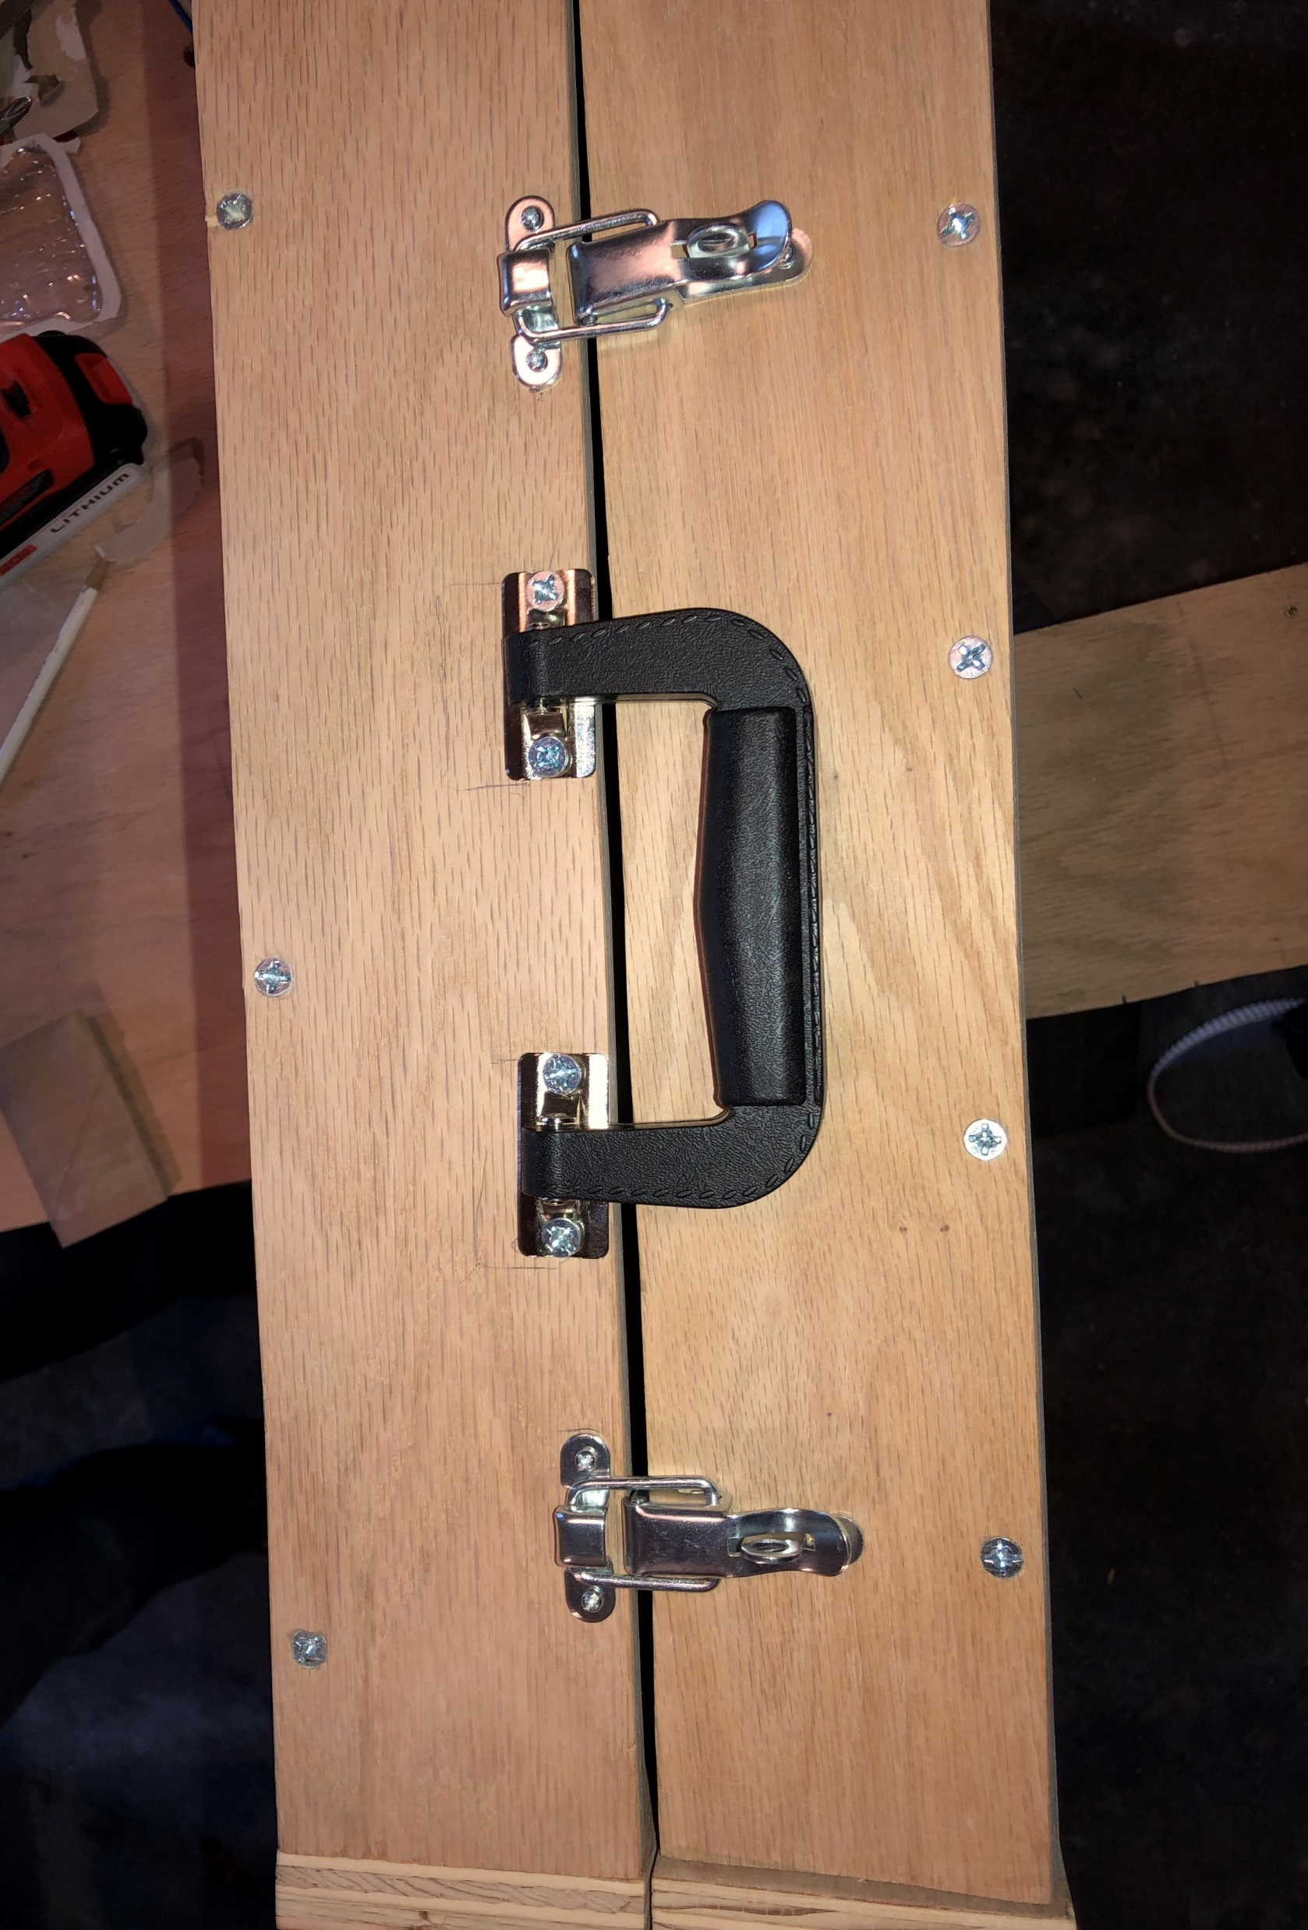
Handle:
The handle is used to make transportation easier. The handle is capable of distributing the mass to the center so that you can carry the briefcase with ease.
We can test how strong the handle is by tying it to a meter that reads forces. Then add weight to the briefcase and see how many pounds (lbs) the handle can handle. (pun intended).
An acceptable carry amount would be 40 lbs. This is because a typical computer is 2-10 lbs, any paper work, the weight of the briefcase, etc all add weight. We want this handle to hold as much as possible just in case. The last thing we want is for someone to be carrying their $1,500 laptop and the handle falls off and your computer breaks.

Slide 5
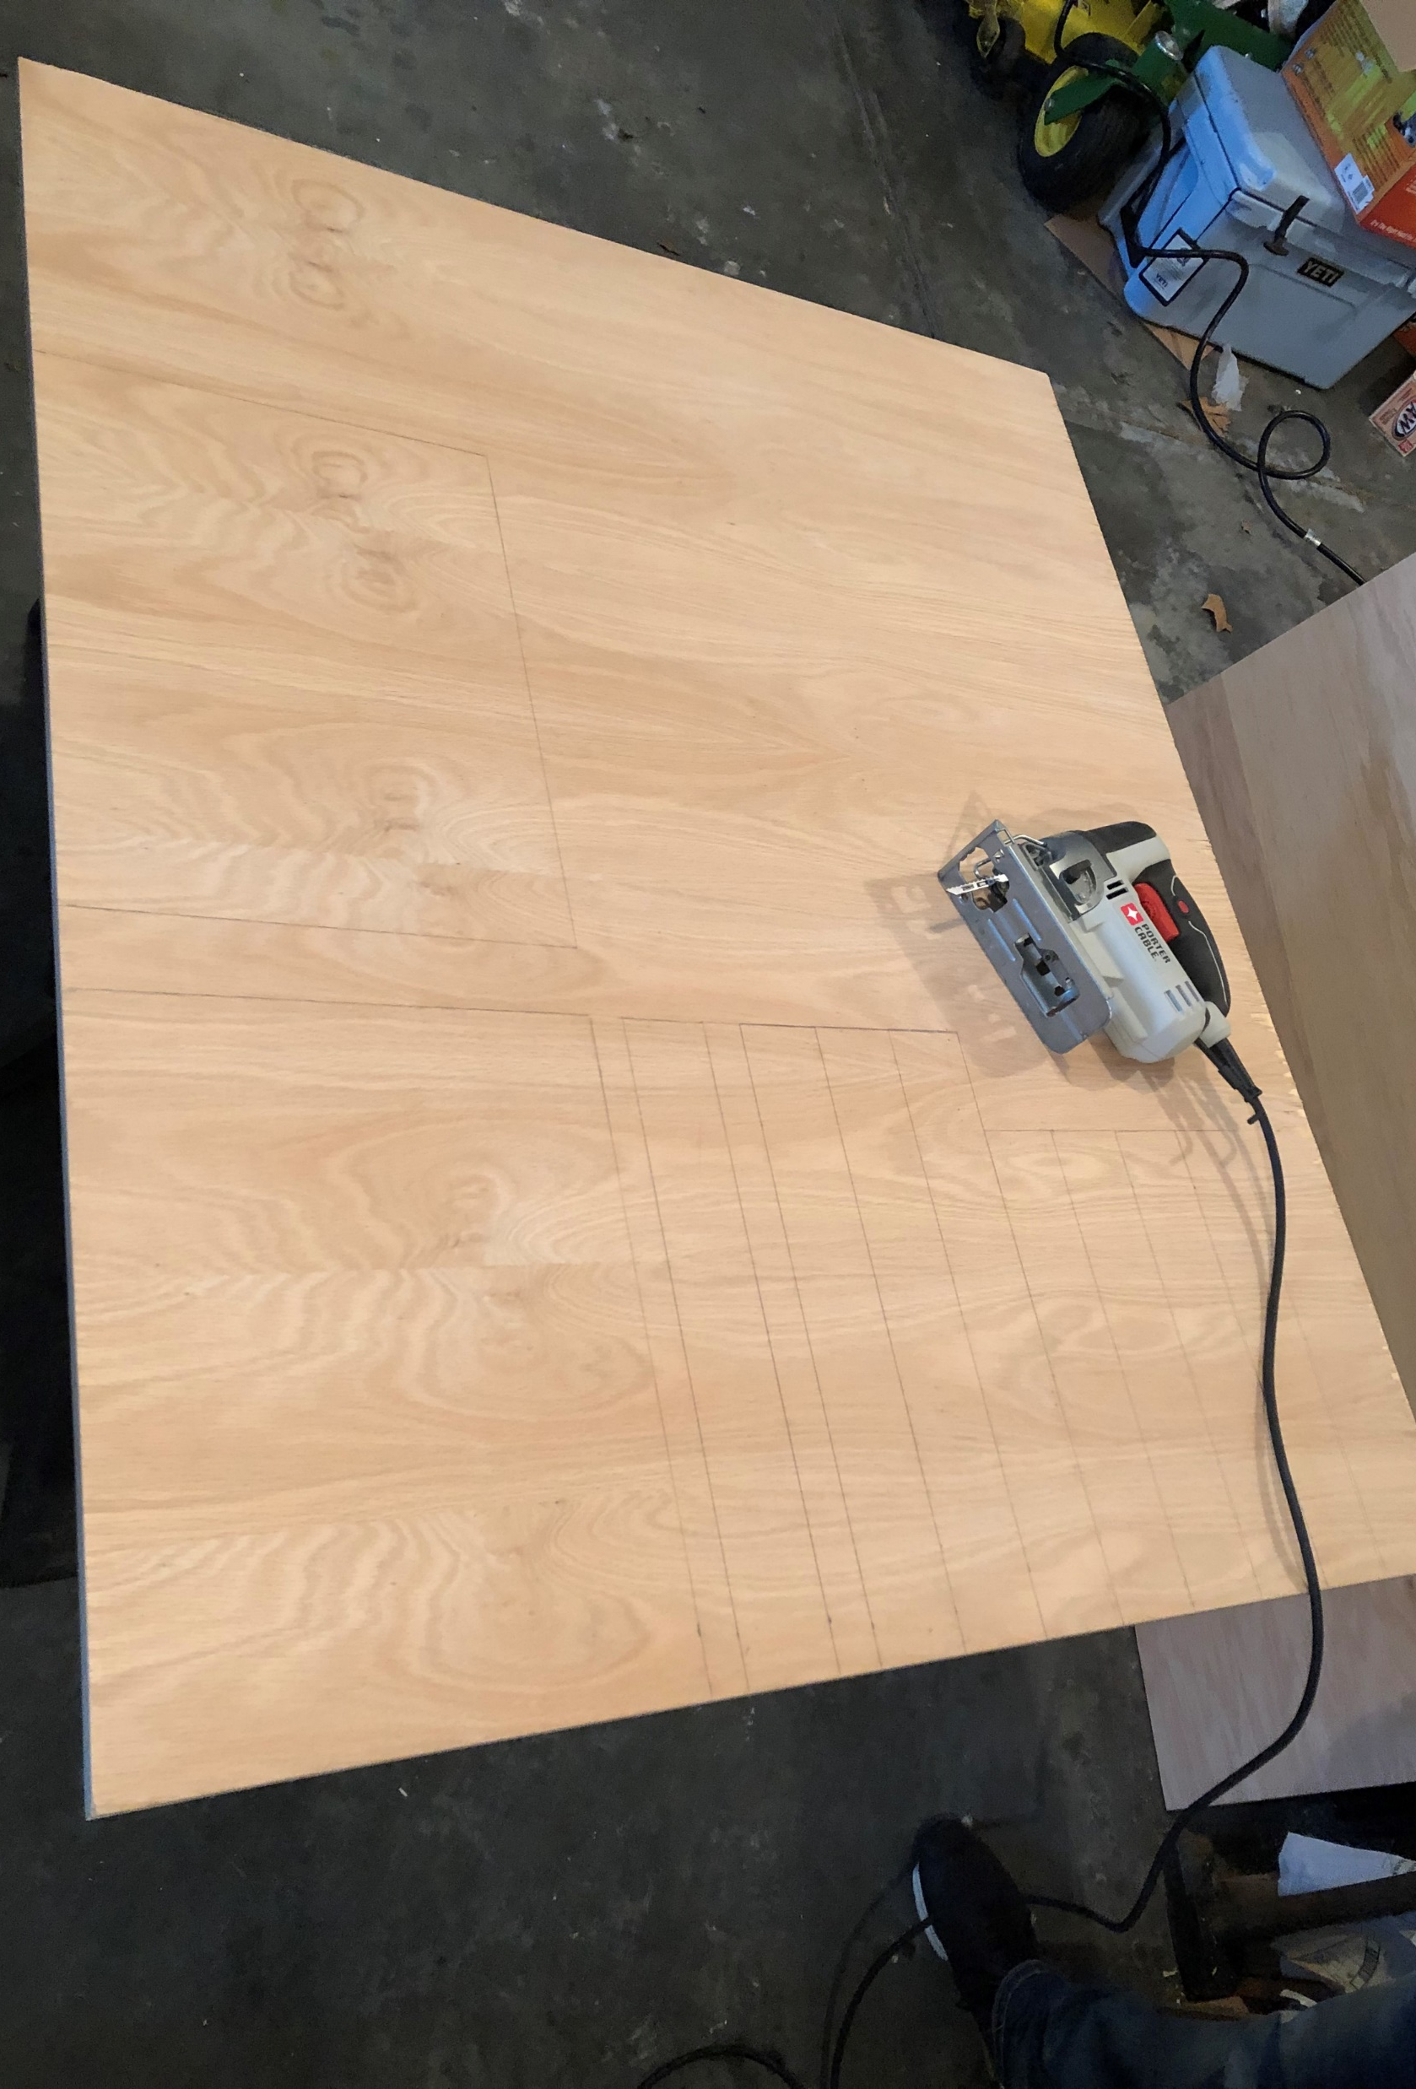
Wood:
The wood is our back bone for our prototype. This prototype and most briefcases are built out of some sort of wood. We would most likely wrap our briefcase in leather but due to the lack of time to build our prototype, and the lack of materials when building our prototype we were unable to add leather at this time. But for our test we would assume that we have leather wrapped around our wood frame.
We would test the wood/leather how well it prevents water from entering. We would do this by pouring water on every part of the briefcase and then checking to see if the water has entered anywhere.
This test would be considered successful if there is no water leakage into the briefcase.

Slide 6

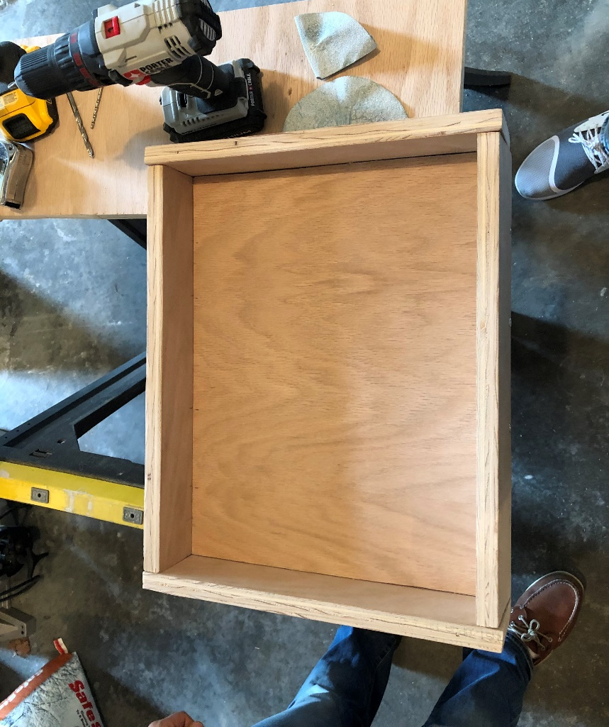
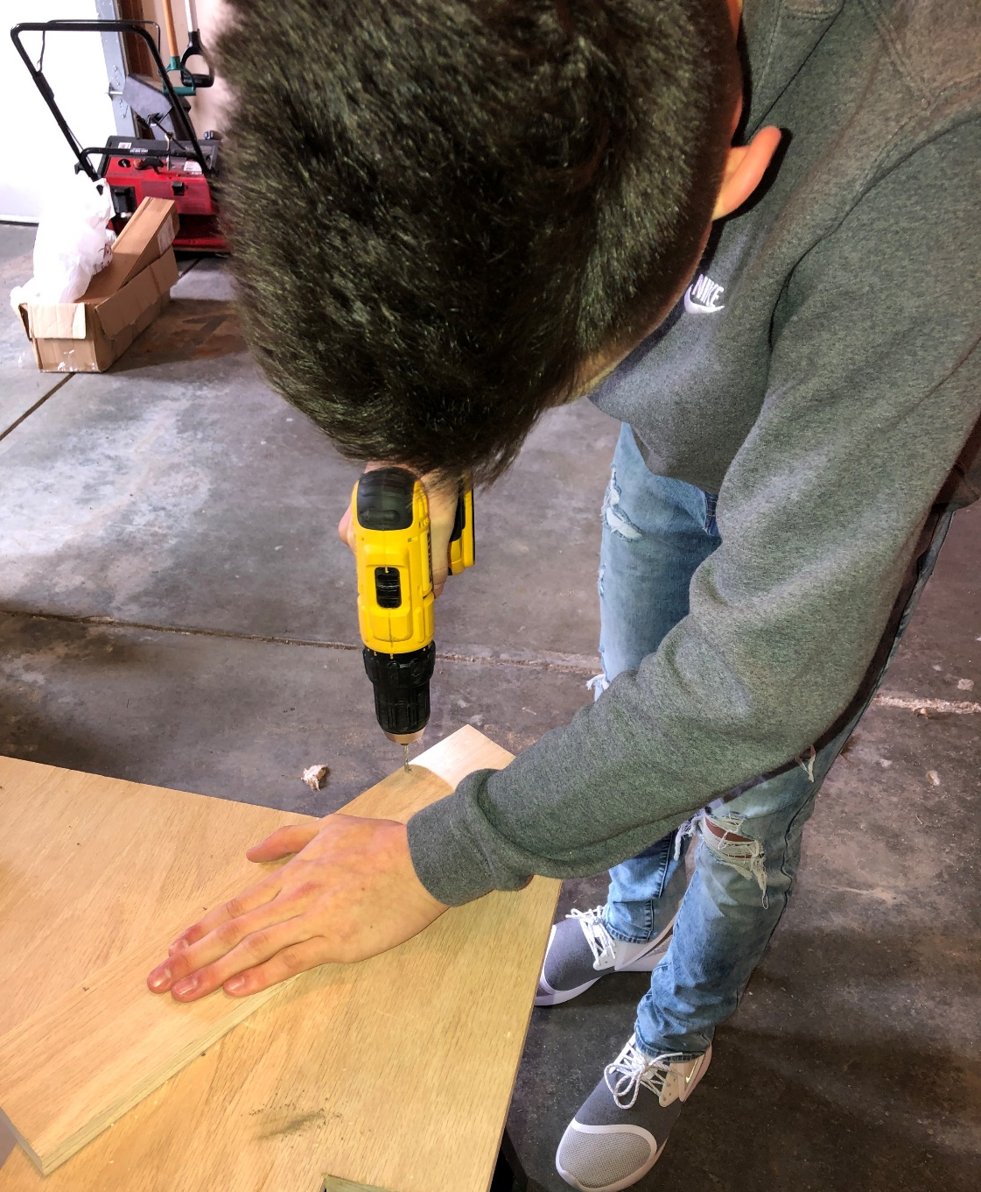
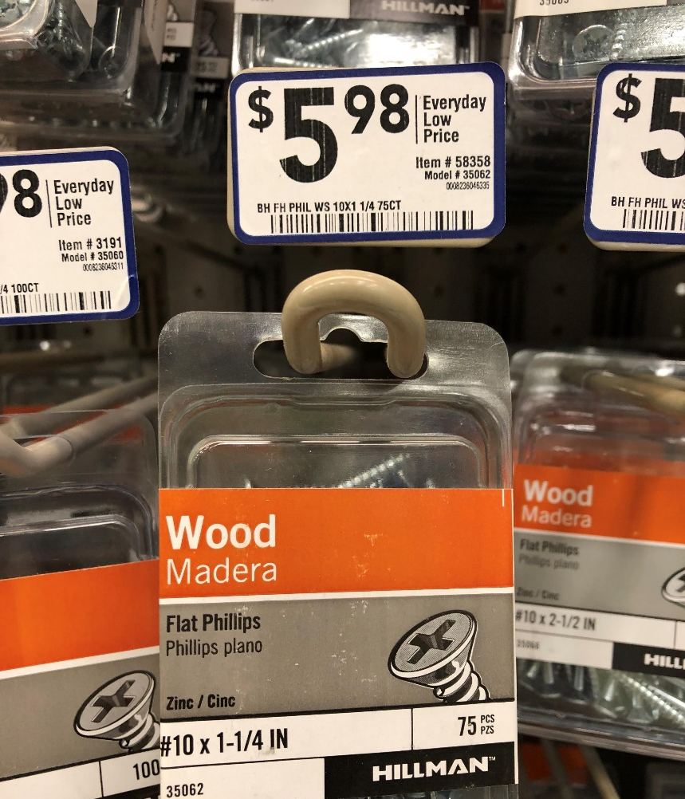
Screws:
The screws are used to ensure that all the components of the prototype stay connected together.
We can test these screws to make sure they will hold inside their medium that they have been screwed into, by screwing screws into different materials and pull on them to test the amount of force it would take to extract them.
An acceptable force needed would be 200N because anything less would be too little.

Slide 7
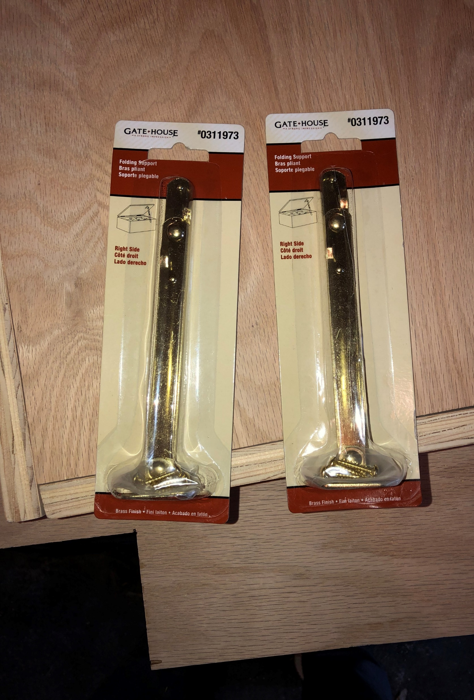
Lever Arm:
The lever arms are used to hold open the briefcase while in use. This is to ensure that the lid does not fall onto your hands while you’re working. This also allows the lid of the briefcase to close much smoother.
We could test these arms by opening and closing them to make sure they function correctly. We would continue to open and close the lid of the briefcase until the metal started to warp, pins/screws start to fall out, and/or that the arms start to come in contact with the walls of the briefcase.
This would be a successful material if the arms take over 5,000+ opening/closings before we see any type of malfunctions.

Slide 8
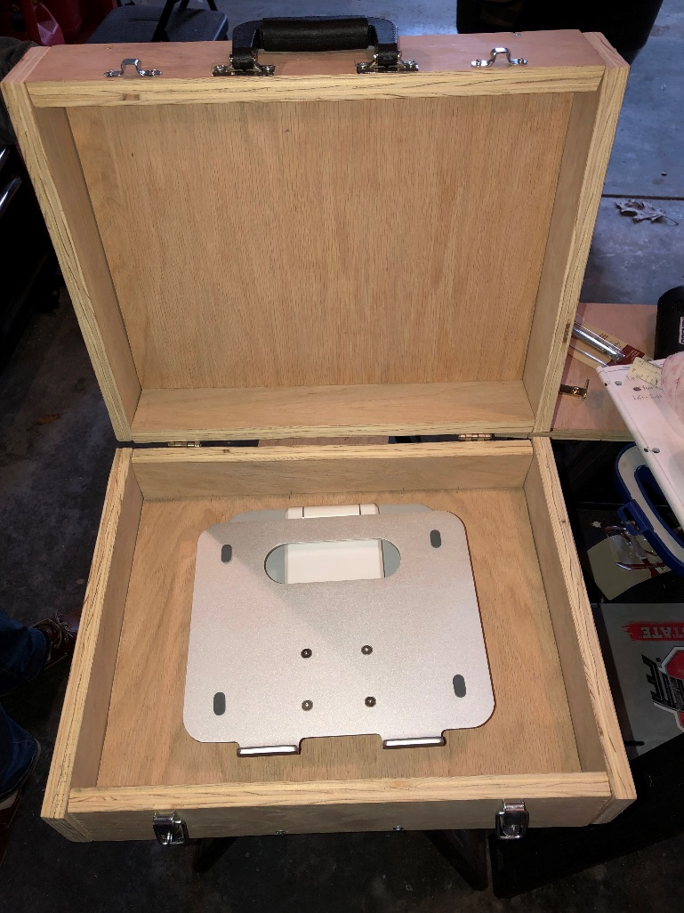
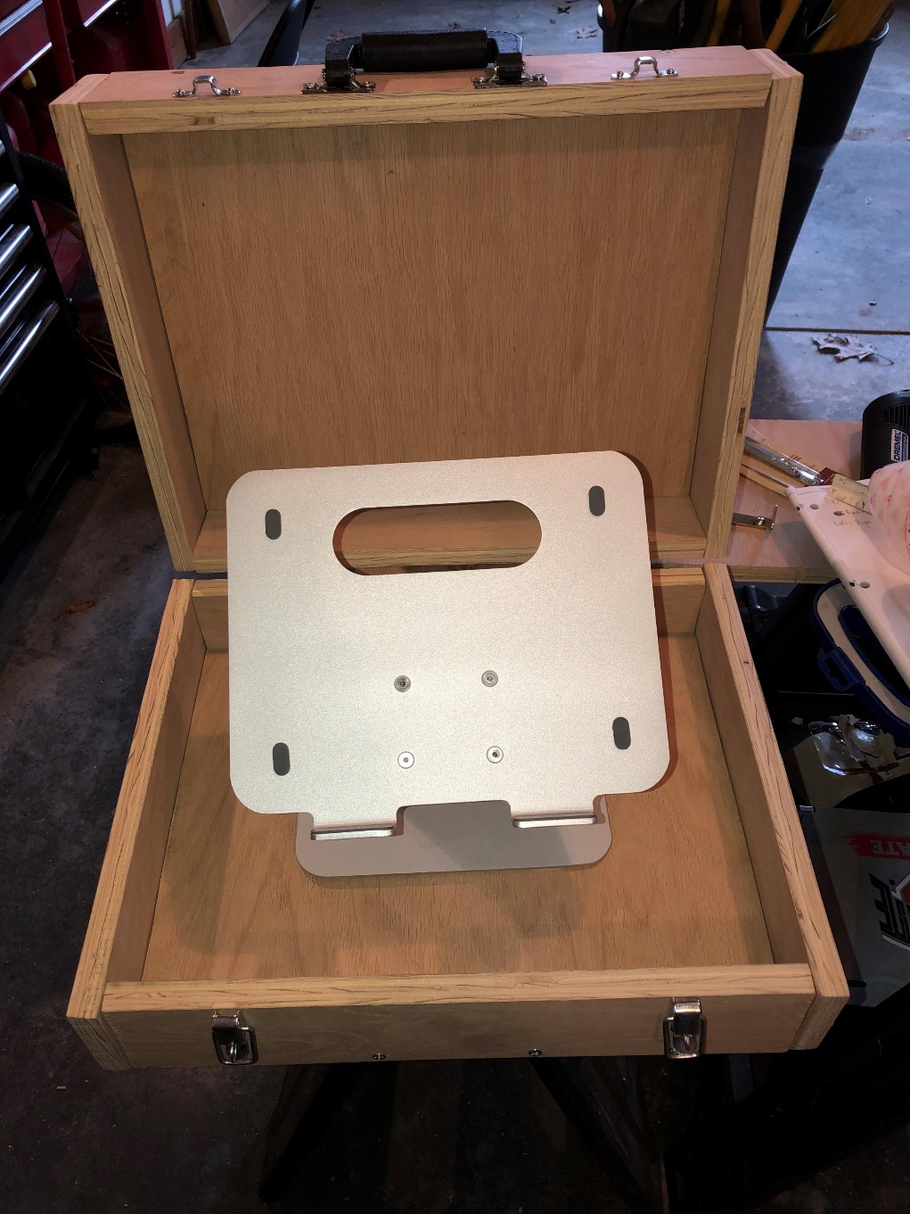
Computer Stand:
The computer stand is used to hold the laptop in the briefcase while working on the computer or while transporting the briefcase from location to location. The computer stand allows the user to stop wherever and pull out their work anywhere.
We would like to test the functionality of this device by testing the efficiency of the computer stand. We would do this by opening the lid, opening the laptop, lifting the computer stand over and over again. We would time this and compare our data to data that is already collected.
This test will be a success if the average time to use our briefcase is faster than the average time it is to pull everything out of a backpack.

