Slide 1
Working on the go
Declan Ruiz & zach shellhorn

Slide 2
What we have done
Defining The Problem
Research
Problem Statements
Community Consultants
Patent Research
Artifacts
Survey
Generating Concepts
Competitive Analysis
Business Plan
Similar Solution Matrix
Design Specifications
Written Project Proposal

Slide 3
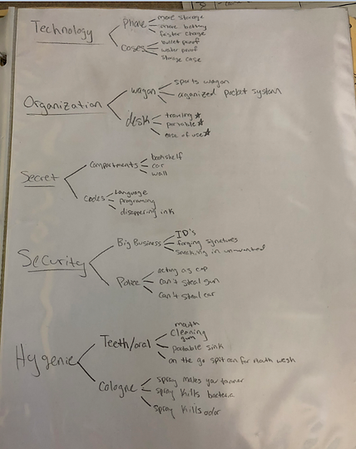
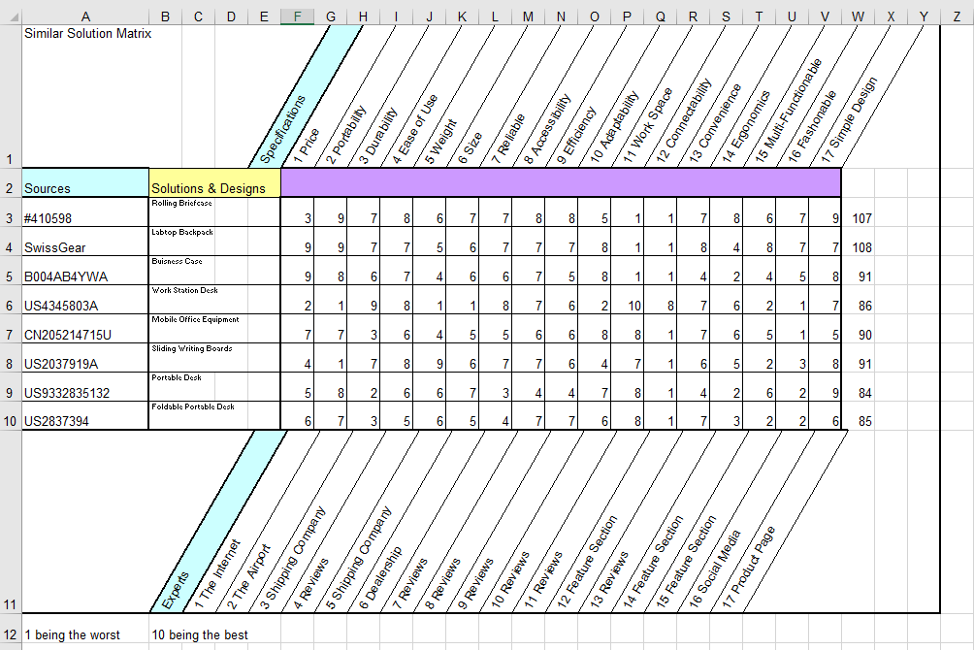
Where we are at
Developing a Solution
Brainstorming
Concept Development
  Isometric and Orthographic Drawings
Selecting a Solution
  Decision Matrix

Slide 4
Problem Statement
Office space costs a lot of money, especially considering the fact that ¾ of the population will be working remotely by 2020. 40% of people check their emails at least five times a day outside their home or office.
Office space costs a lot, as little as $1.74/sq ft. in Atlanta to as much as $6.16/sq ft. in Los Angeles, which is why ¾ of the population will be working remotely by 2020. With office space being expensive, business men/women, teachers, entrepreneurs, salesman, etc. are looking for efficient ways to work on the go since 40% of people check their emails at least 5 times a day outside the house or office.

Slide 5
research
General Research
10 Artifacts
6 Patents
Feedback from Community Consultants
Market Research
Working On The Go Survey
Results of Survey
Concept Test Survey

Slide 6
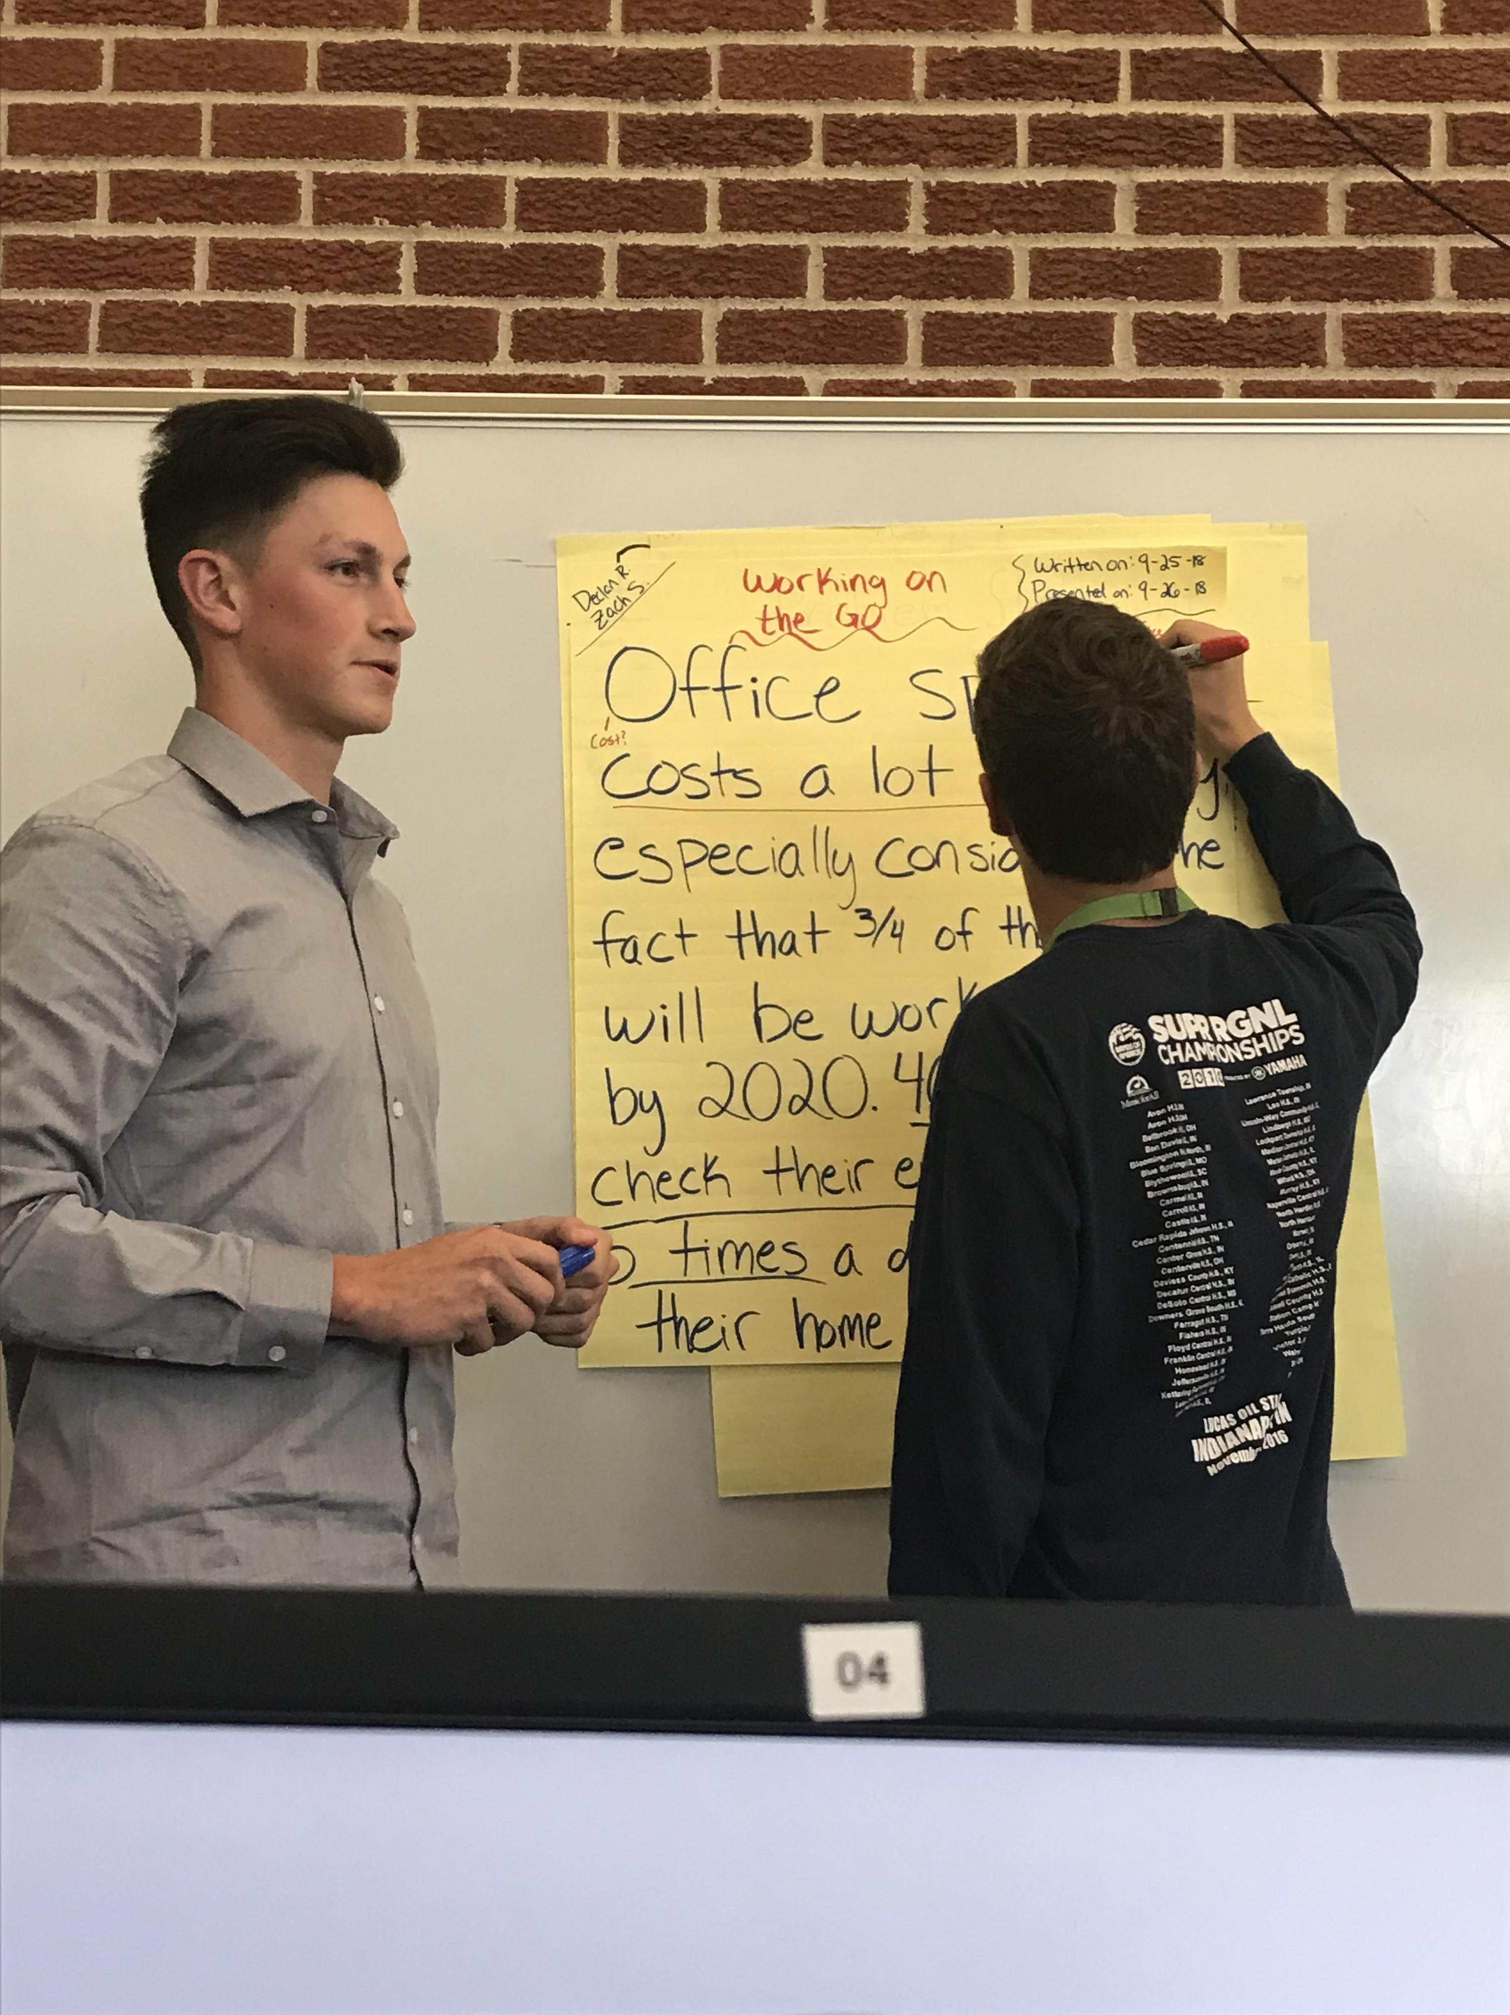
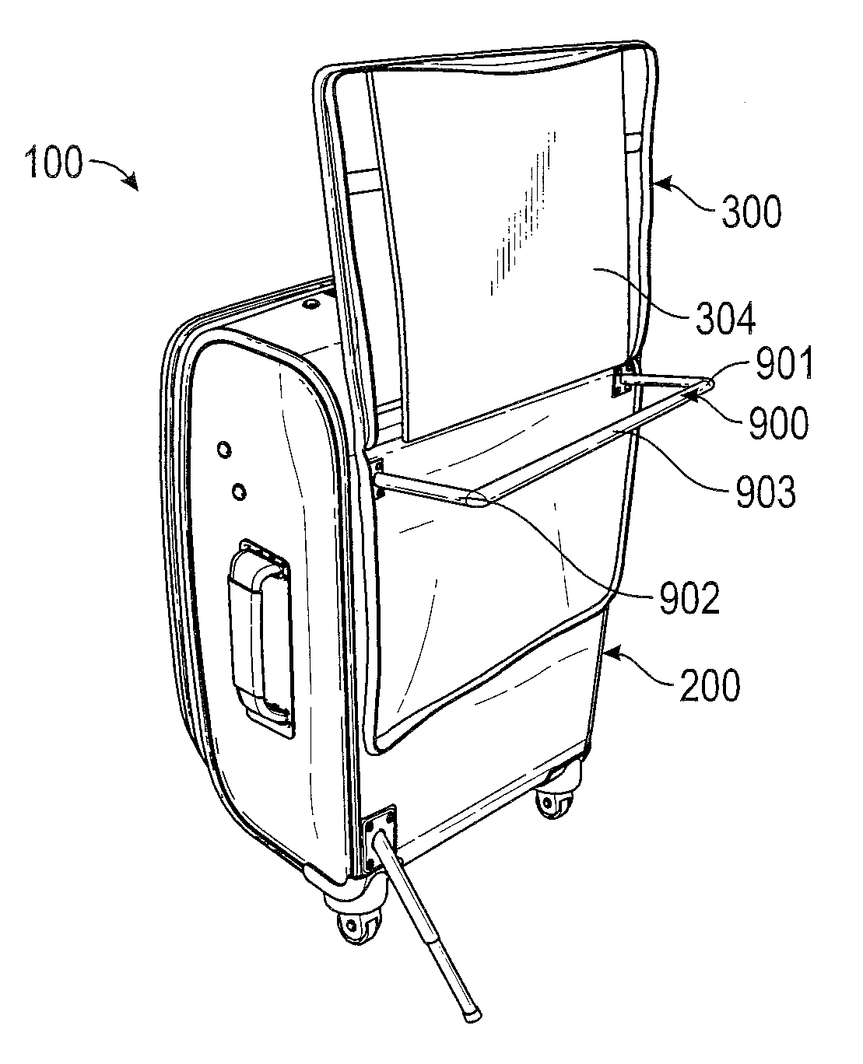
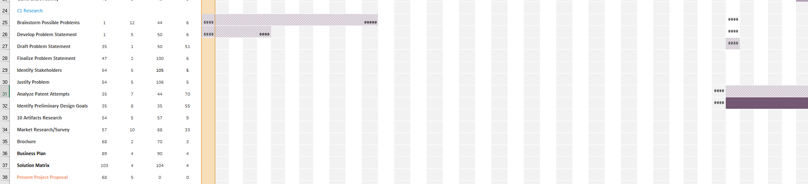
Challenges
Time Management
Public Speaking
Credible Research

Slide 7
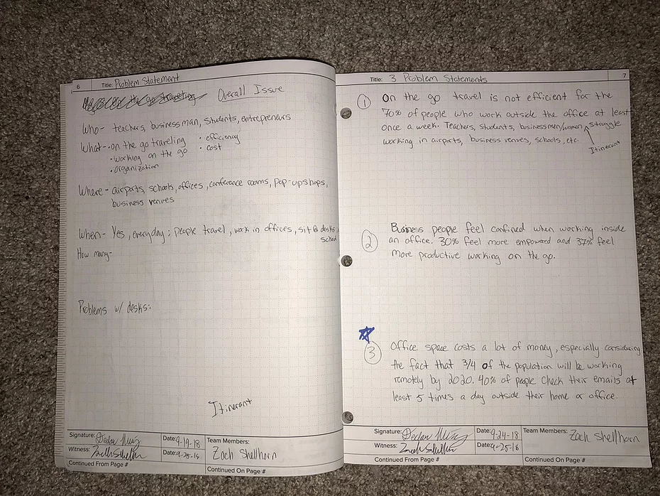
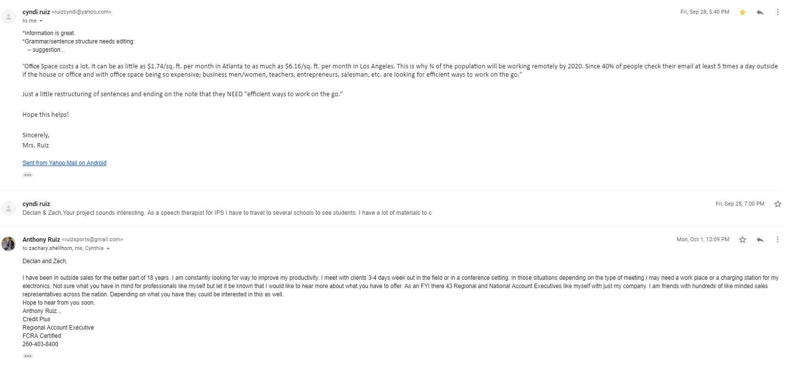
Learning experiences
Documentation
Brainstorming
Communication
Working with Others
Volunteer Work

Slide 8


Community Consultants and Mentors
C.F. Roark Welding Co Inc.
Eli Lilly
Diebold Nixdorf
Credit Plus
Habitat for Humanity
IPS

Slide 9
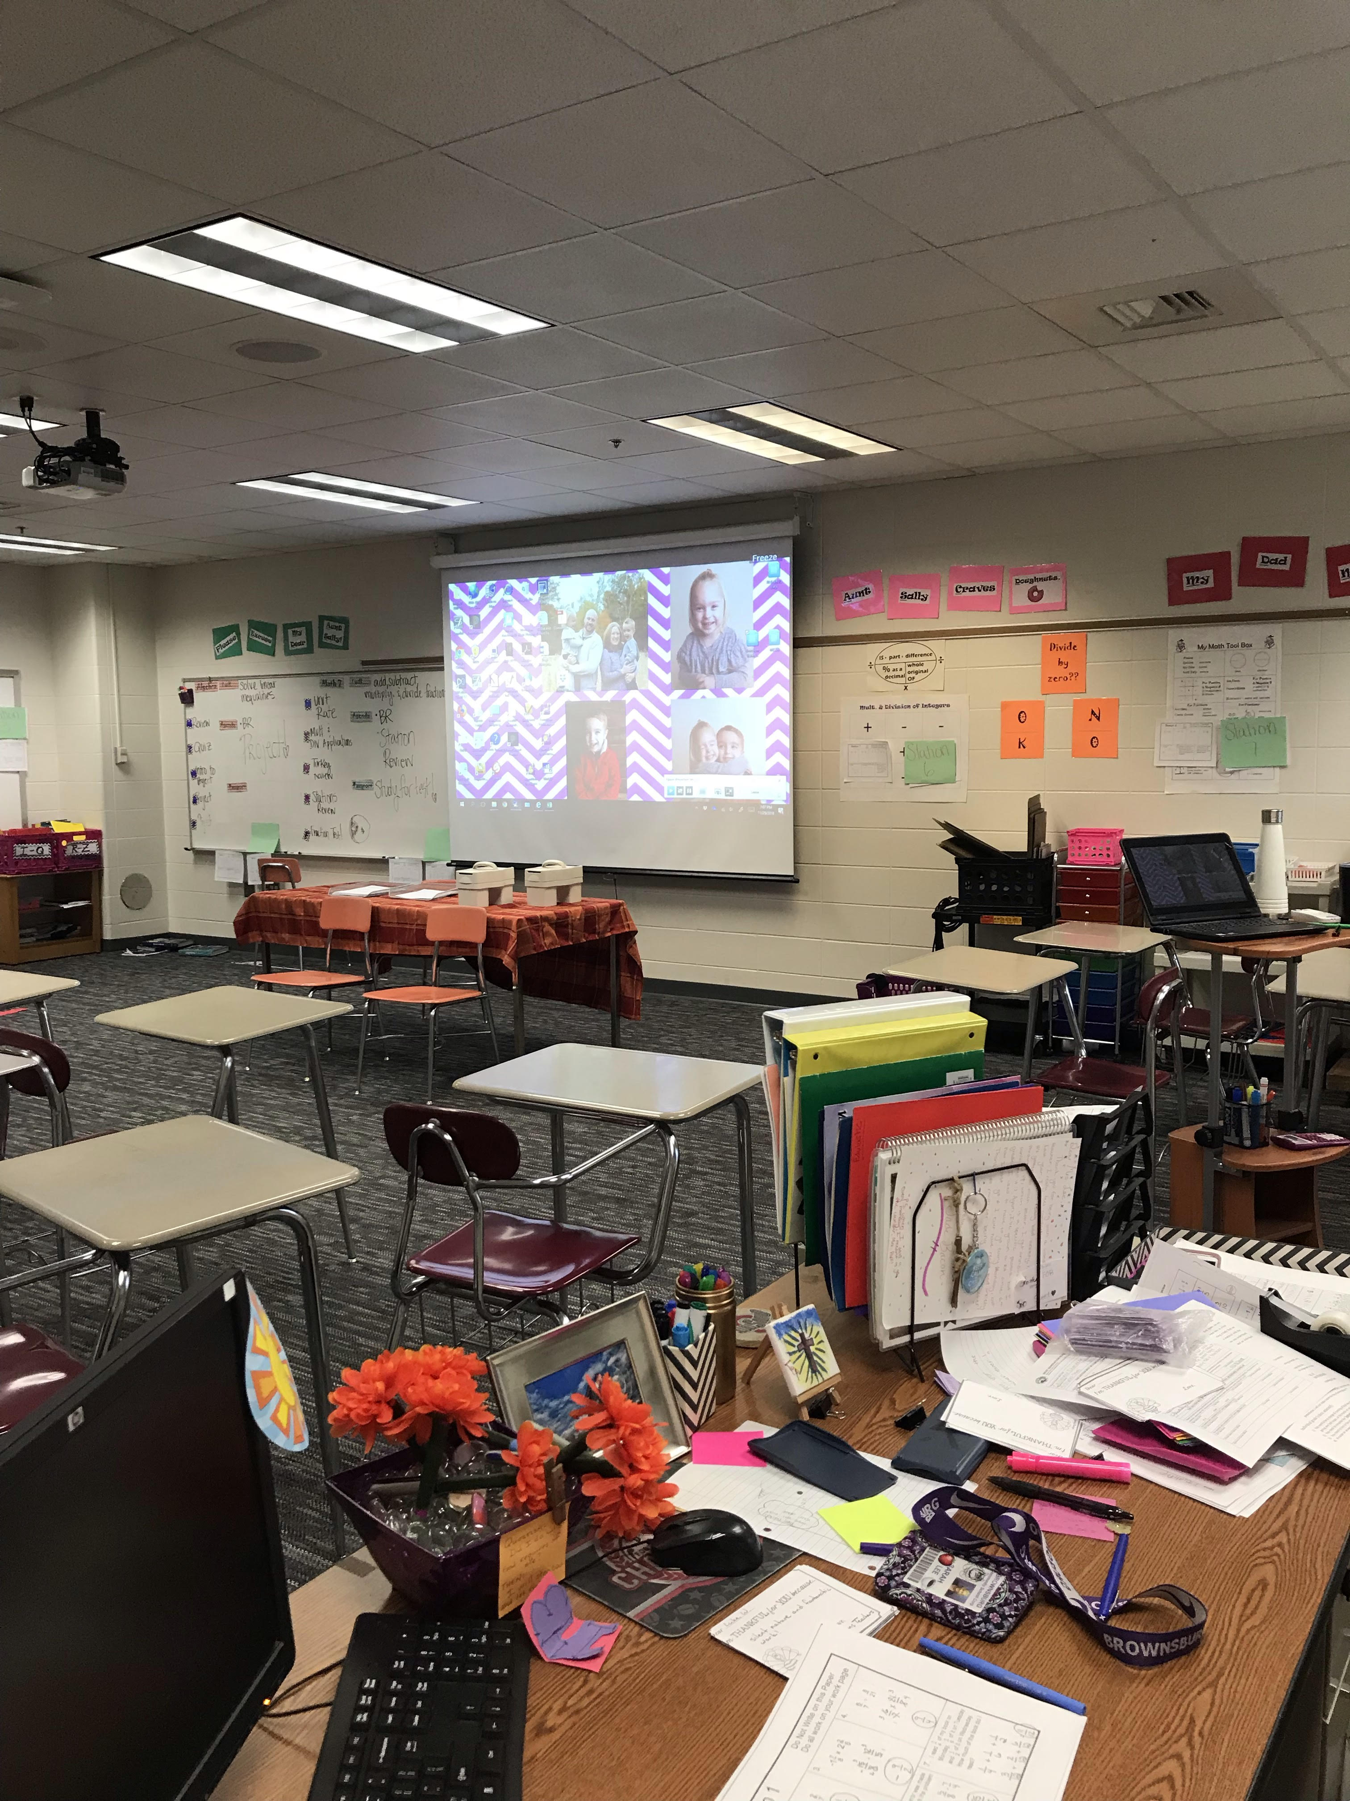
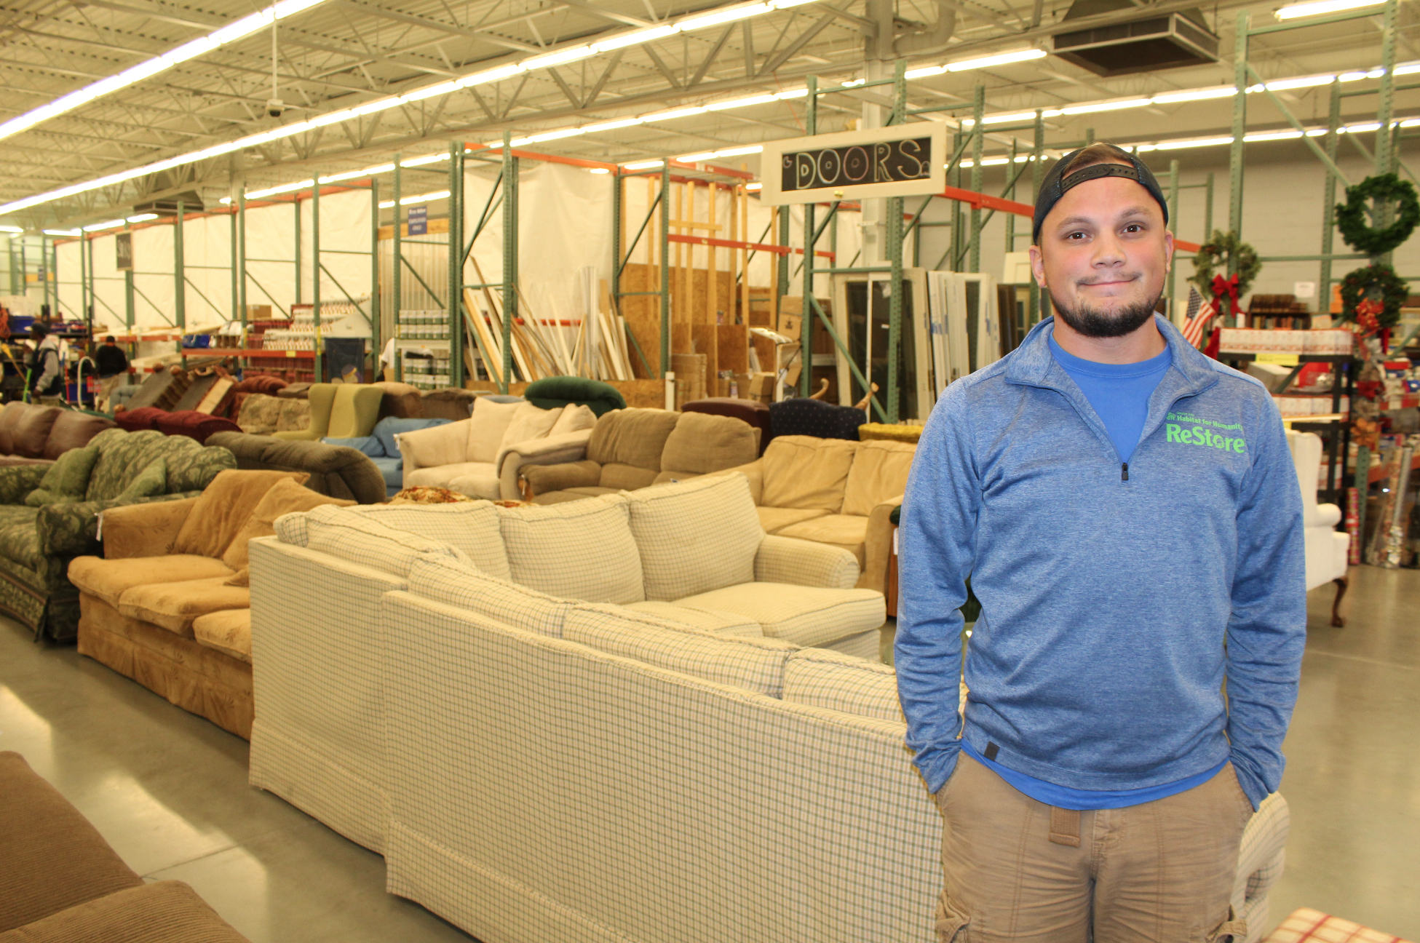
Volunteer work
Avon Restore – Habitat for Humanity
Brownsburg West Middle School

Slide 10


What is next?
Developing a Prototype
Working with Consultants
Testing Prototype
Documenting Results
Presenting Final Solution

Slide 11

Questions

