Slide 1
Test & Evaluate
Declan Ruiz & Zach Shellhorn

Slide 2
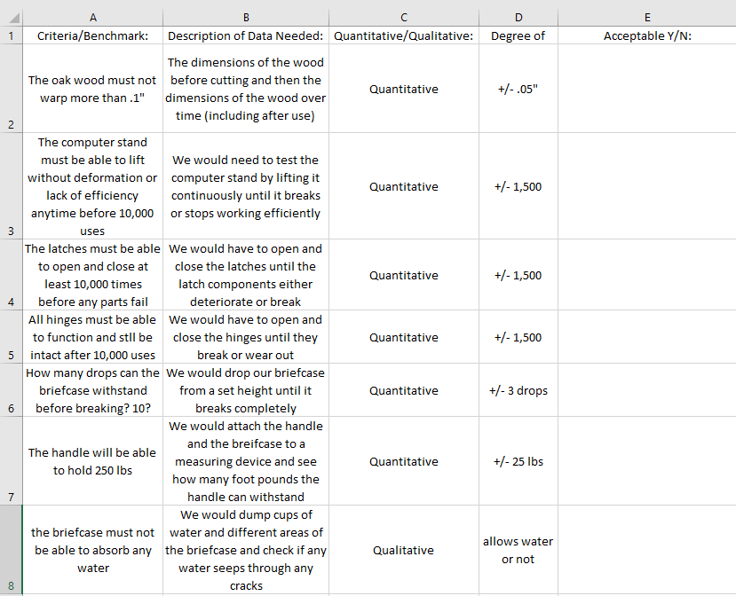
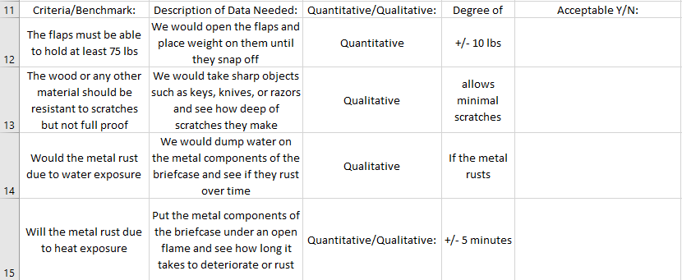
Test Criteria

Slide 3
Summary of the Latch Test:
The latches that are attached to the briefcase allow it to stay closed as well as be locked if needed. These latches will be opened and closed many times when the briefcase will be in use. The objective of this test it to test the durability and strength of the parts in the latch by opening and closing them. Within reasonable testing the latch should still be functional.

Slide 4
Video of Testing Latches

Slide 5
Summary of the Hinge Test:
The hinges on the back of the briefcase are aluminum hinges that we purchased from Lowe’s. They are acting as the backbone of the project because they holding the lid and the bottom together. The objective of this test is to see if the hinges fail. We will know if it fails, if the top and bottom components fall apart. On the contrary, the test will be considered successful if no parts of the hinges malfunction, and the top and bottom components stay intact during the entire duration of the testing process.

Slide 6
Video of Testing Hinges

Slide 7
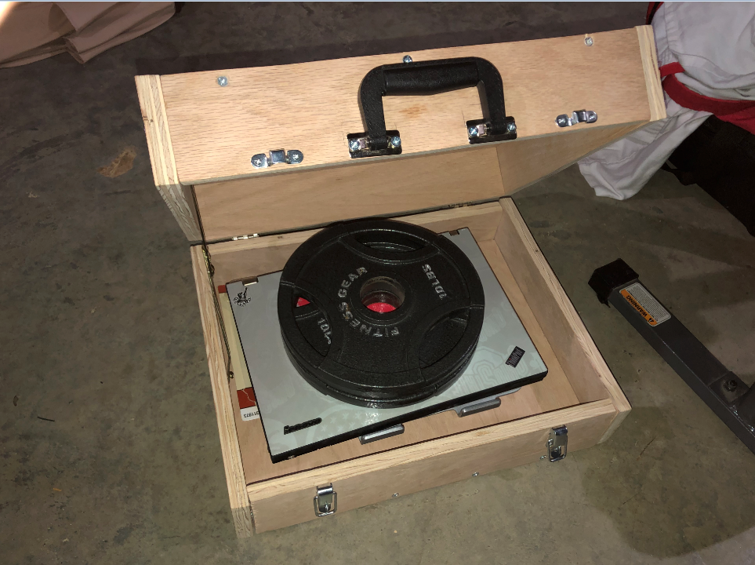
Summary of the Handle Test:
The handle is made of TCH plastic and metal fixtures. Our plan with this test is to identify how much weight it can withstand. This handle is placed in the exact middle, to distribute the actual force / normal force evenly. The idea is to see if our handle will succeed by holding significant amounts of weight because if it cannot then everything inside could be severely damaged. This is why it is an important part of our project to test.

Slide 8
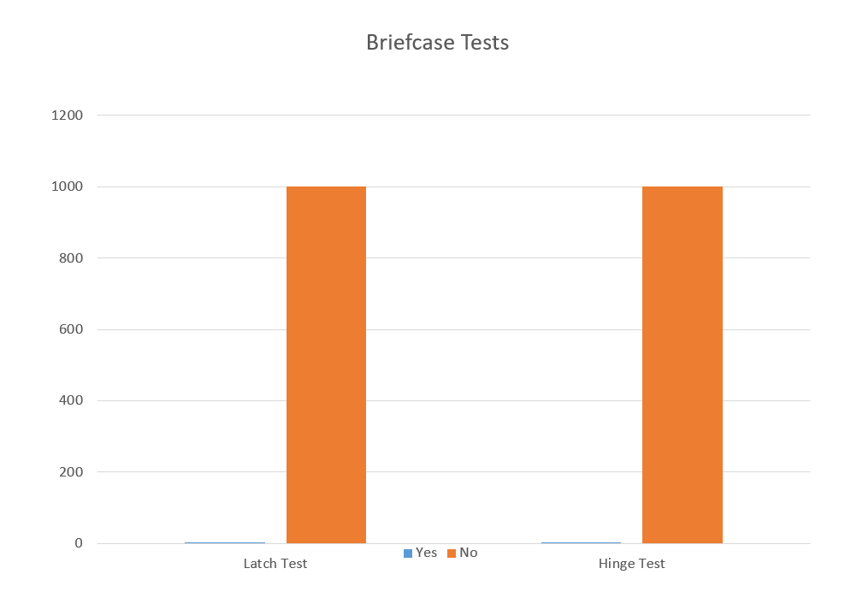
Data:
In our tests we were testing to see if the latch or hinge would break upon use. After 1,000 repetitions of each test we realized that our data is inconclusive. After 1,000 repetitions neither the latches nor the hinges broke or deformed in any way.
We attempted to do a 3rd test on the handle but due to the weight we were trying to use, it wasn’t possible to complete the test

Slide 9
Expert FeedBack/Modifications
Make the briefcase lighter
Wrap in leather to give it a better look
Make bottom half thicker than top half to fit computer/computer stand.

