Slide 1

Briefcase Build Procedure
Declan Ruiz & Zach Shellhorn

Slide 2
Parts List:
1 sheet of ¾” Oak Hardwood (.703” x 3.997’ x 7.997’) (4x8)
4 qty. - 3 -½” stainless steel hinges
2 qty. – Zinc Lockable Draw Catch
75 ct. – Wood flat Philips #10 x 1-1/4” screws
1 qty. – TCH Hardware Black Plastic Briefcase Handle
1 qty. – Skyzonal Aluminum Notebook Desktop Stand Height Adjustable Laptop Stand for Computer PC Notebook MacBook iPad

Slide 3
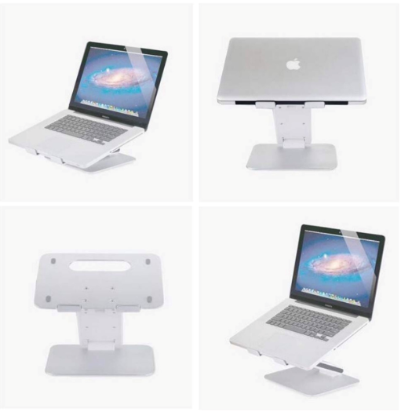
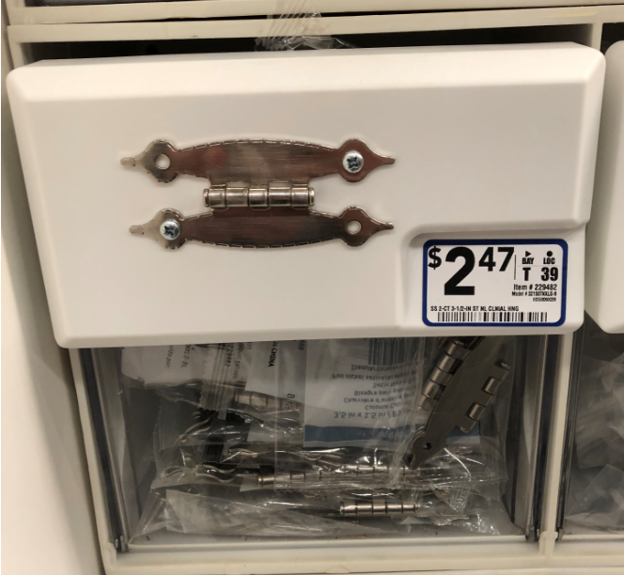
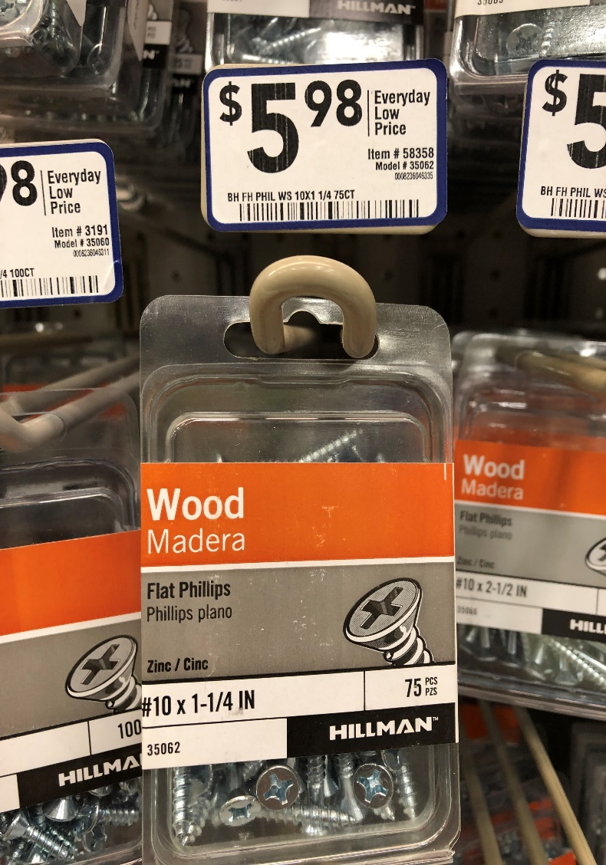
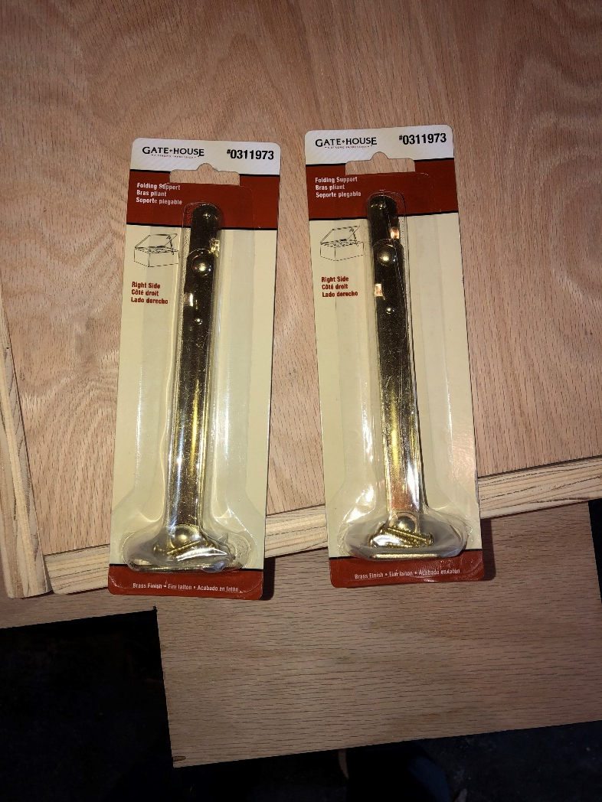
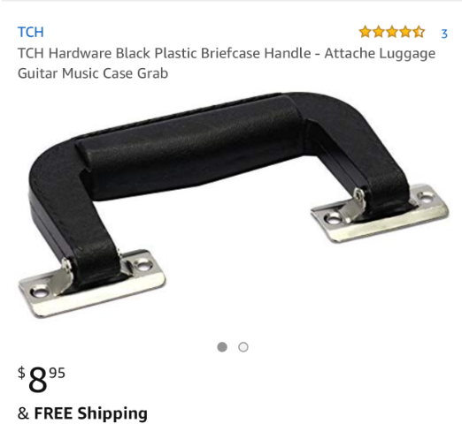
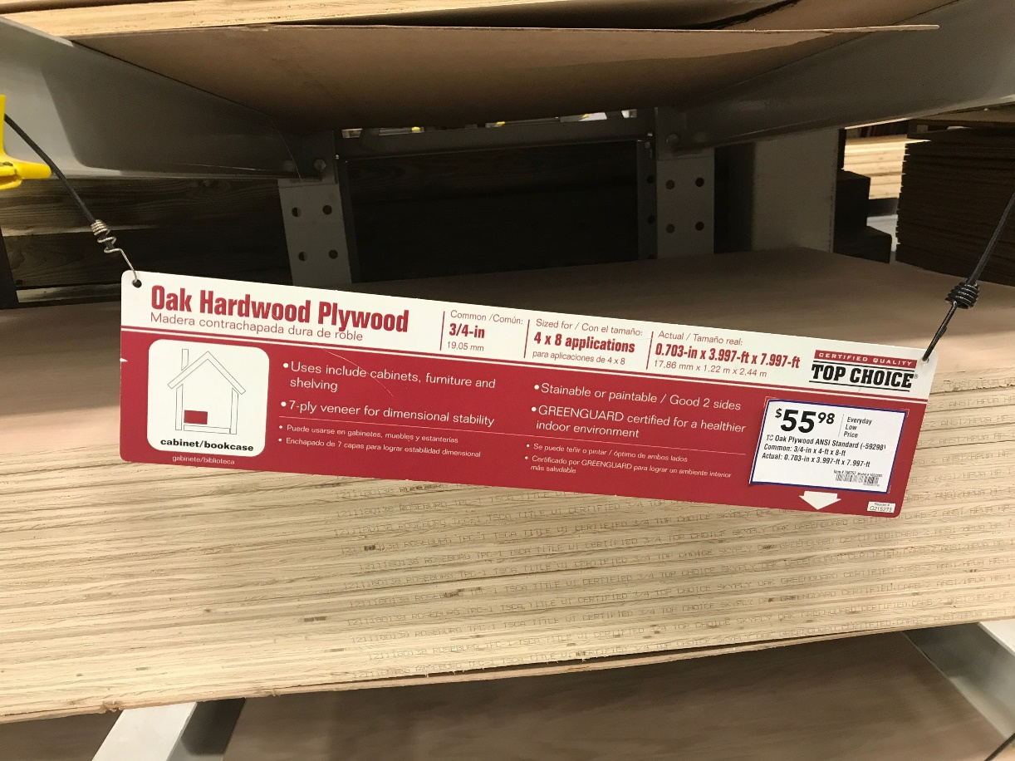
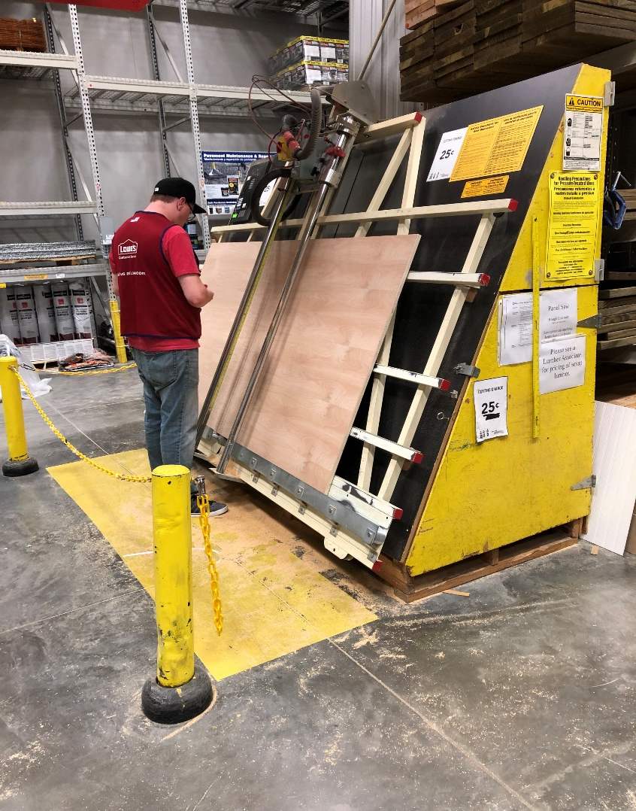
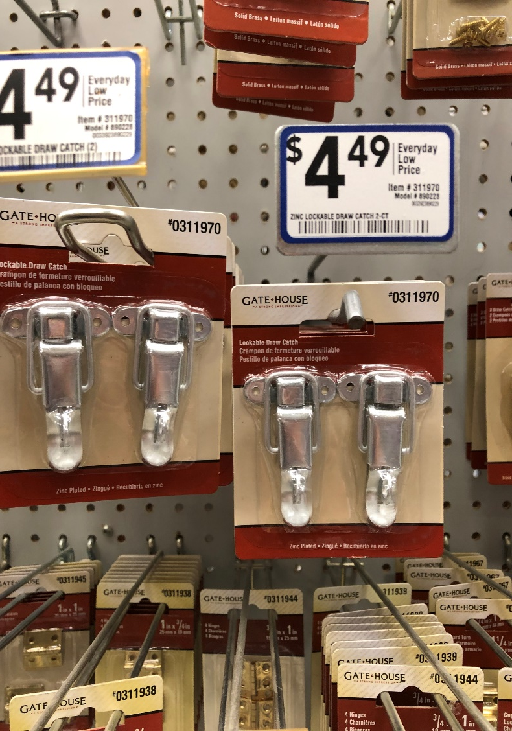
Materials:

Slide 4
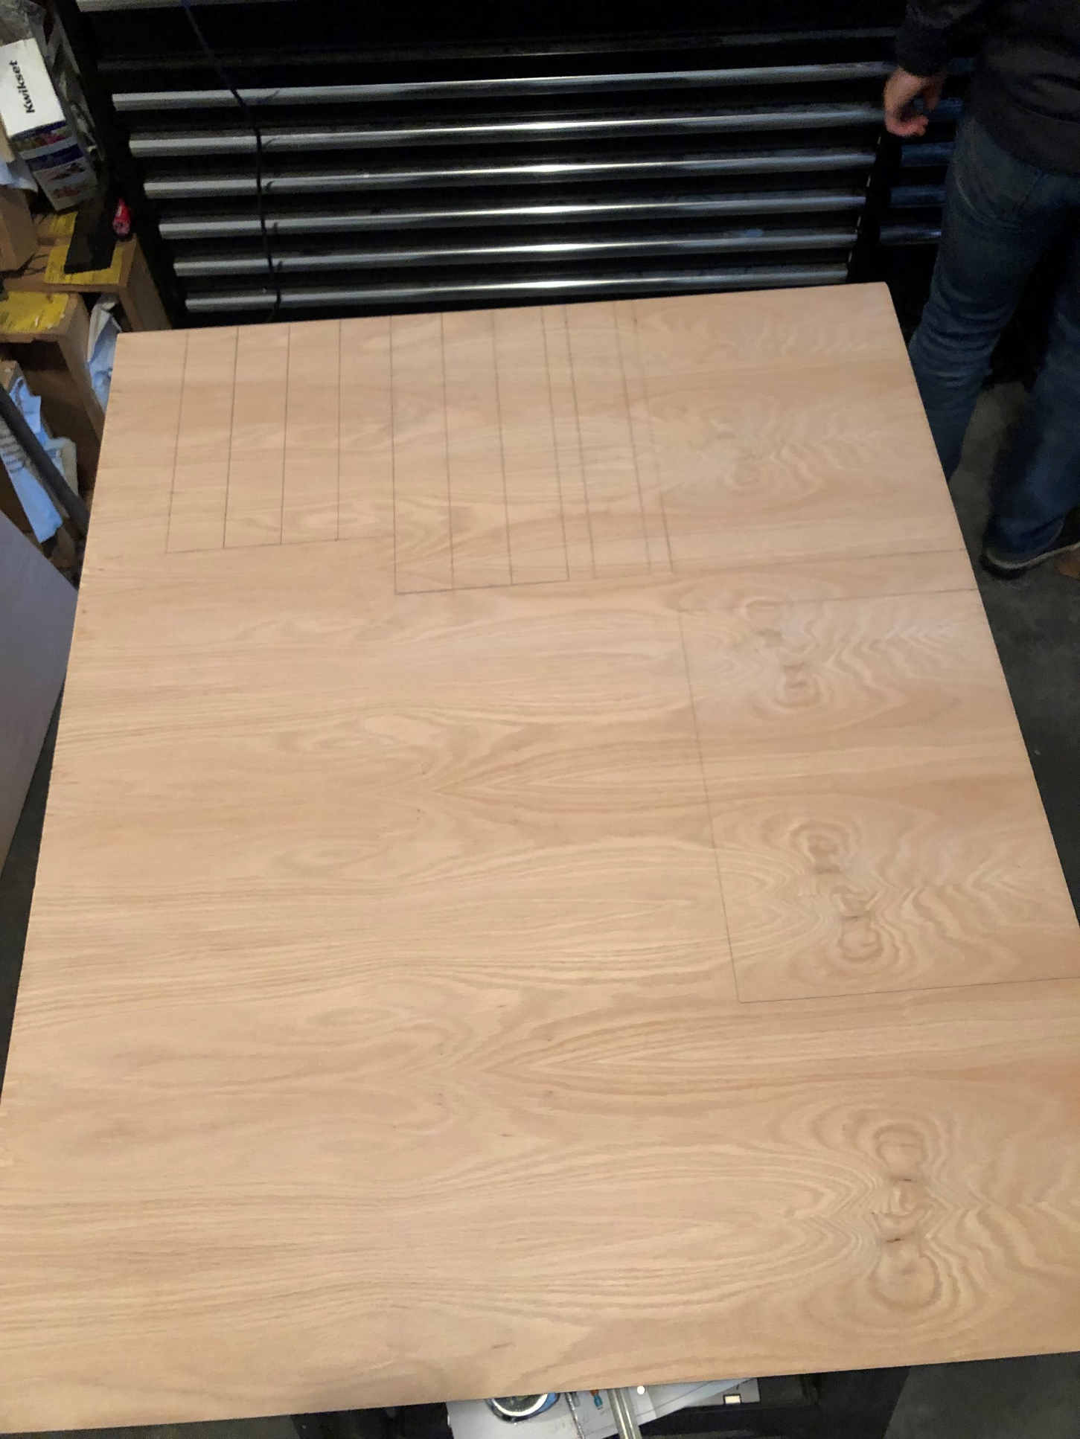
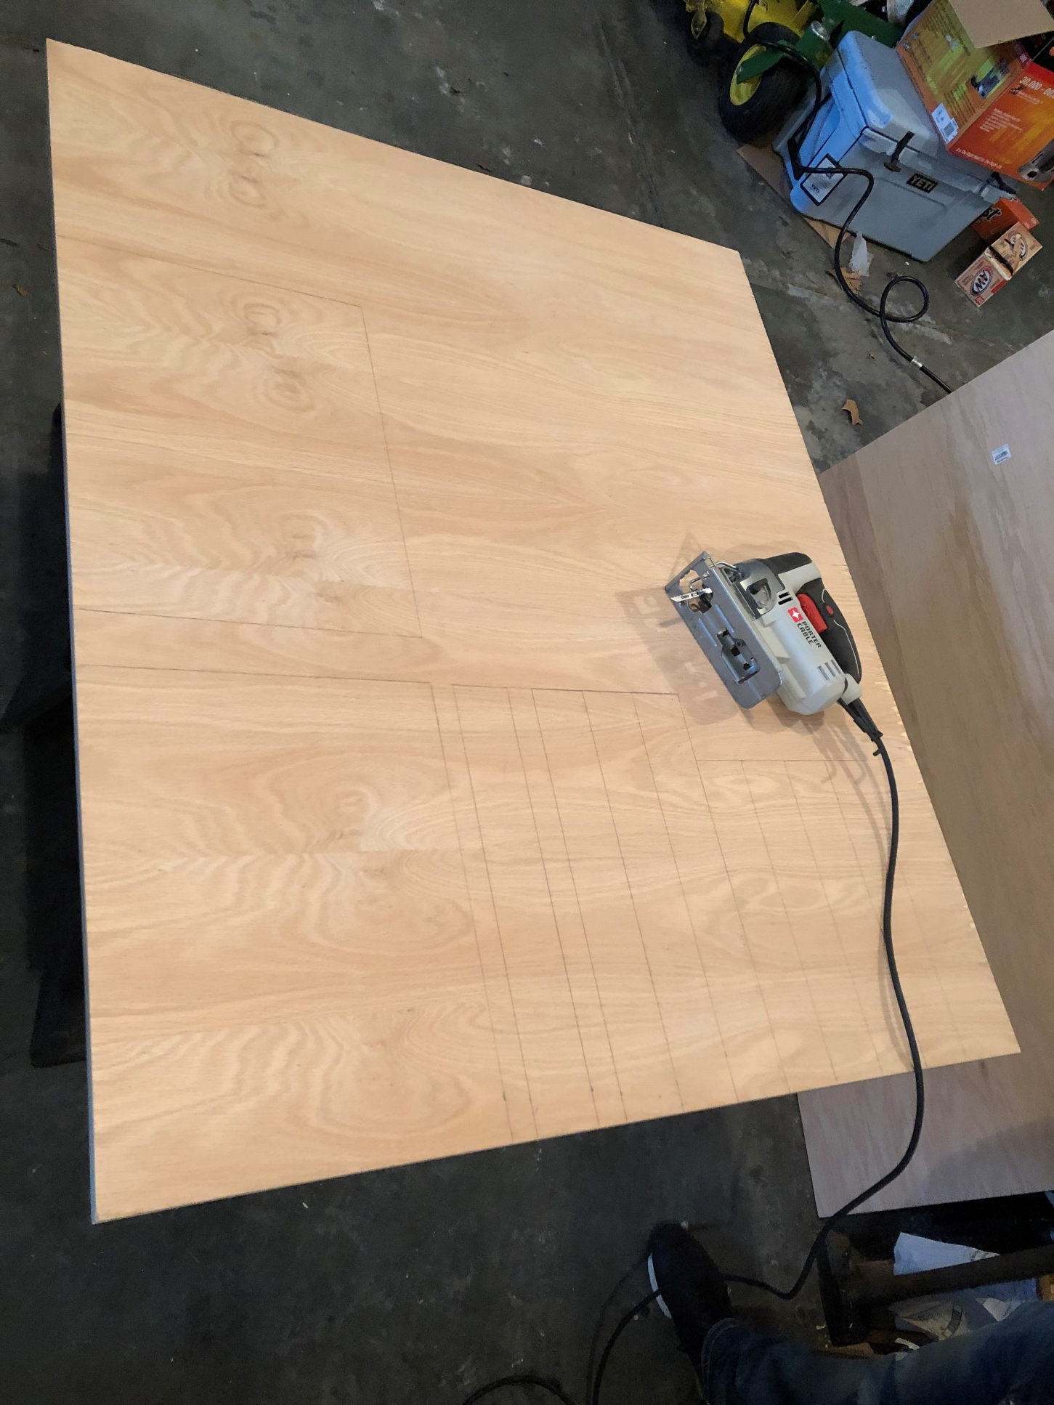
Step 0:
Measure the main pieces & Draw them out on the wood

Slide 5
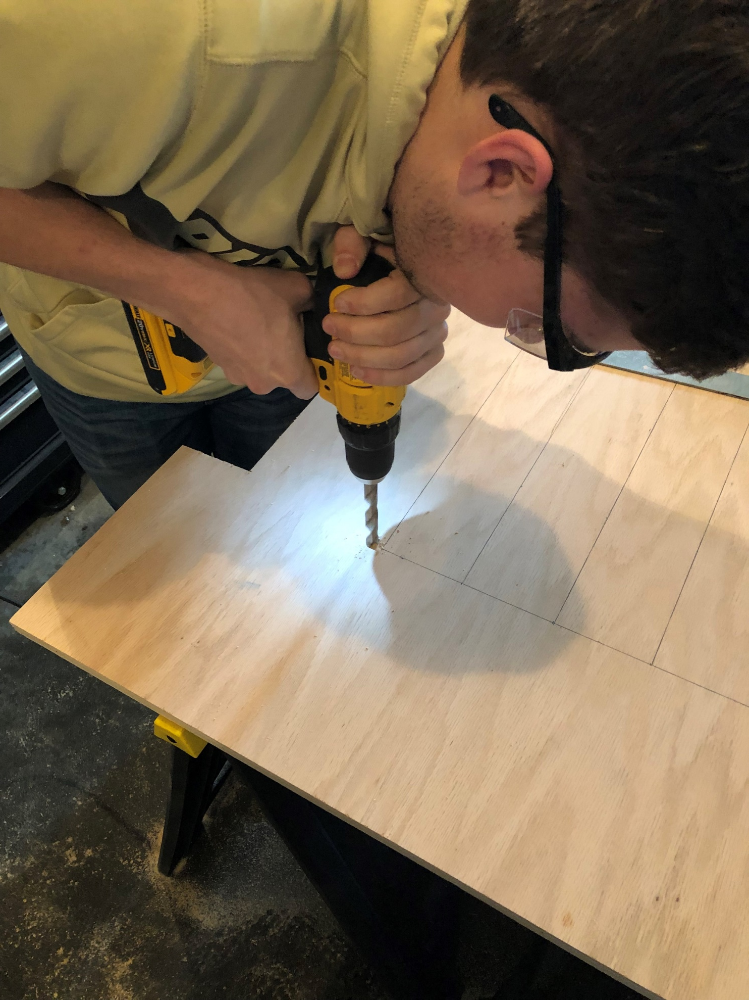

Step 1:
Cut the wood to the correct sizes

Slide 6
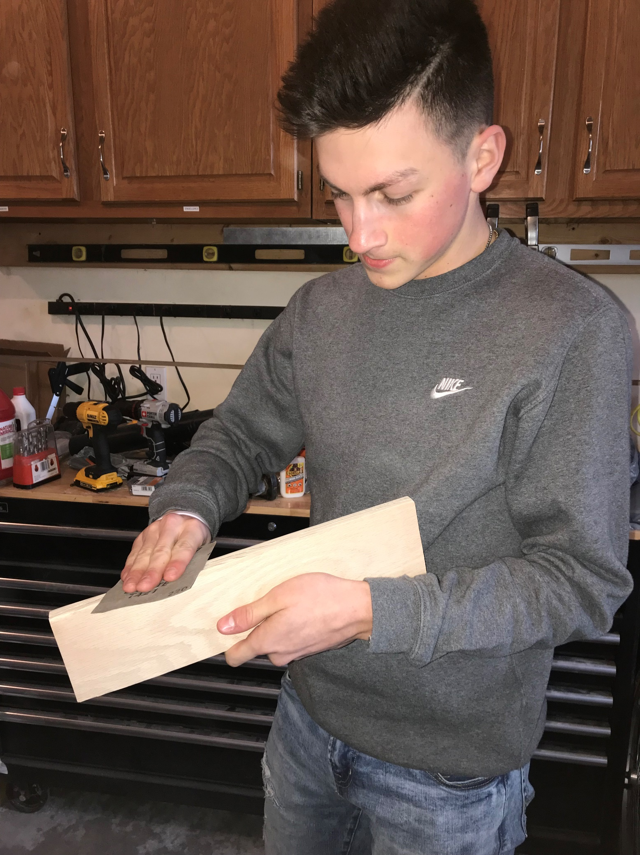
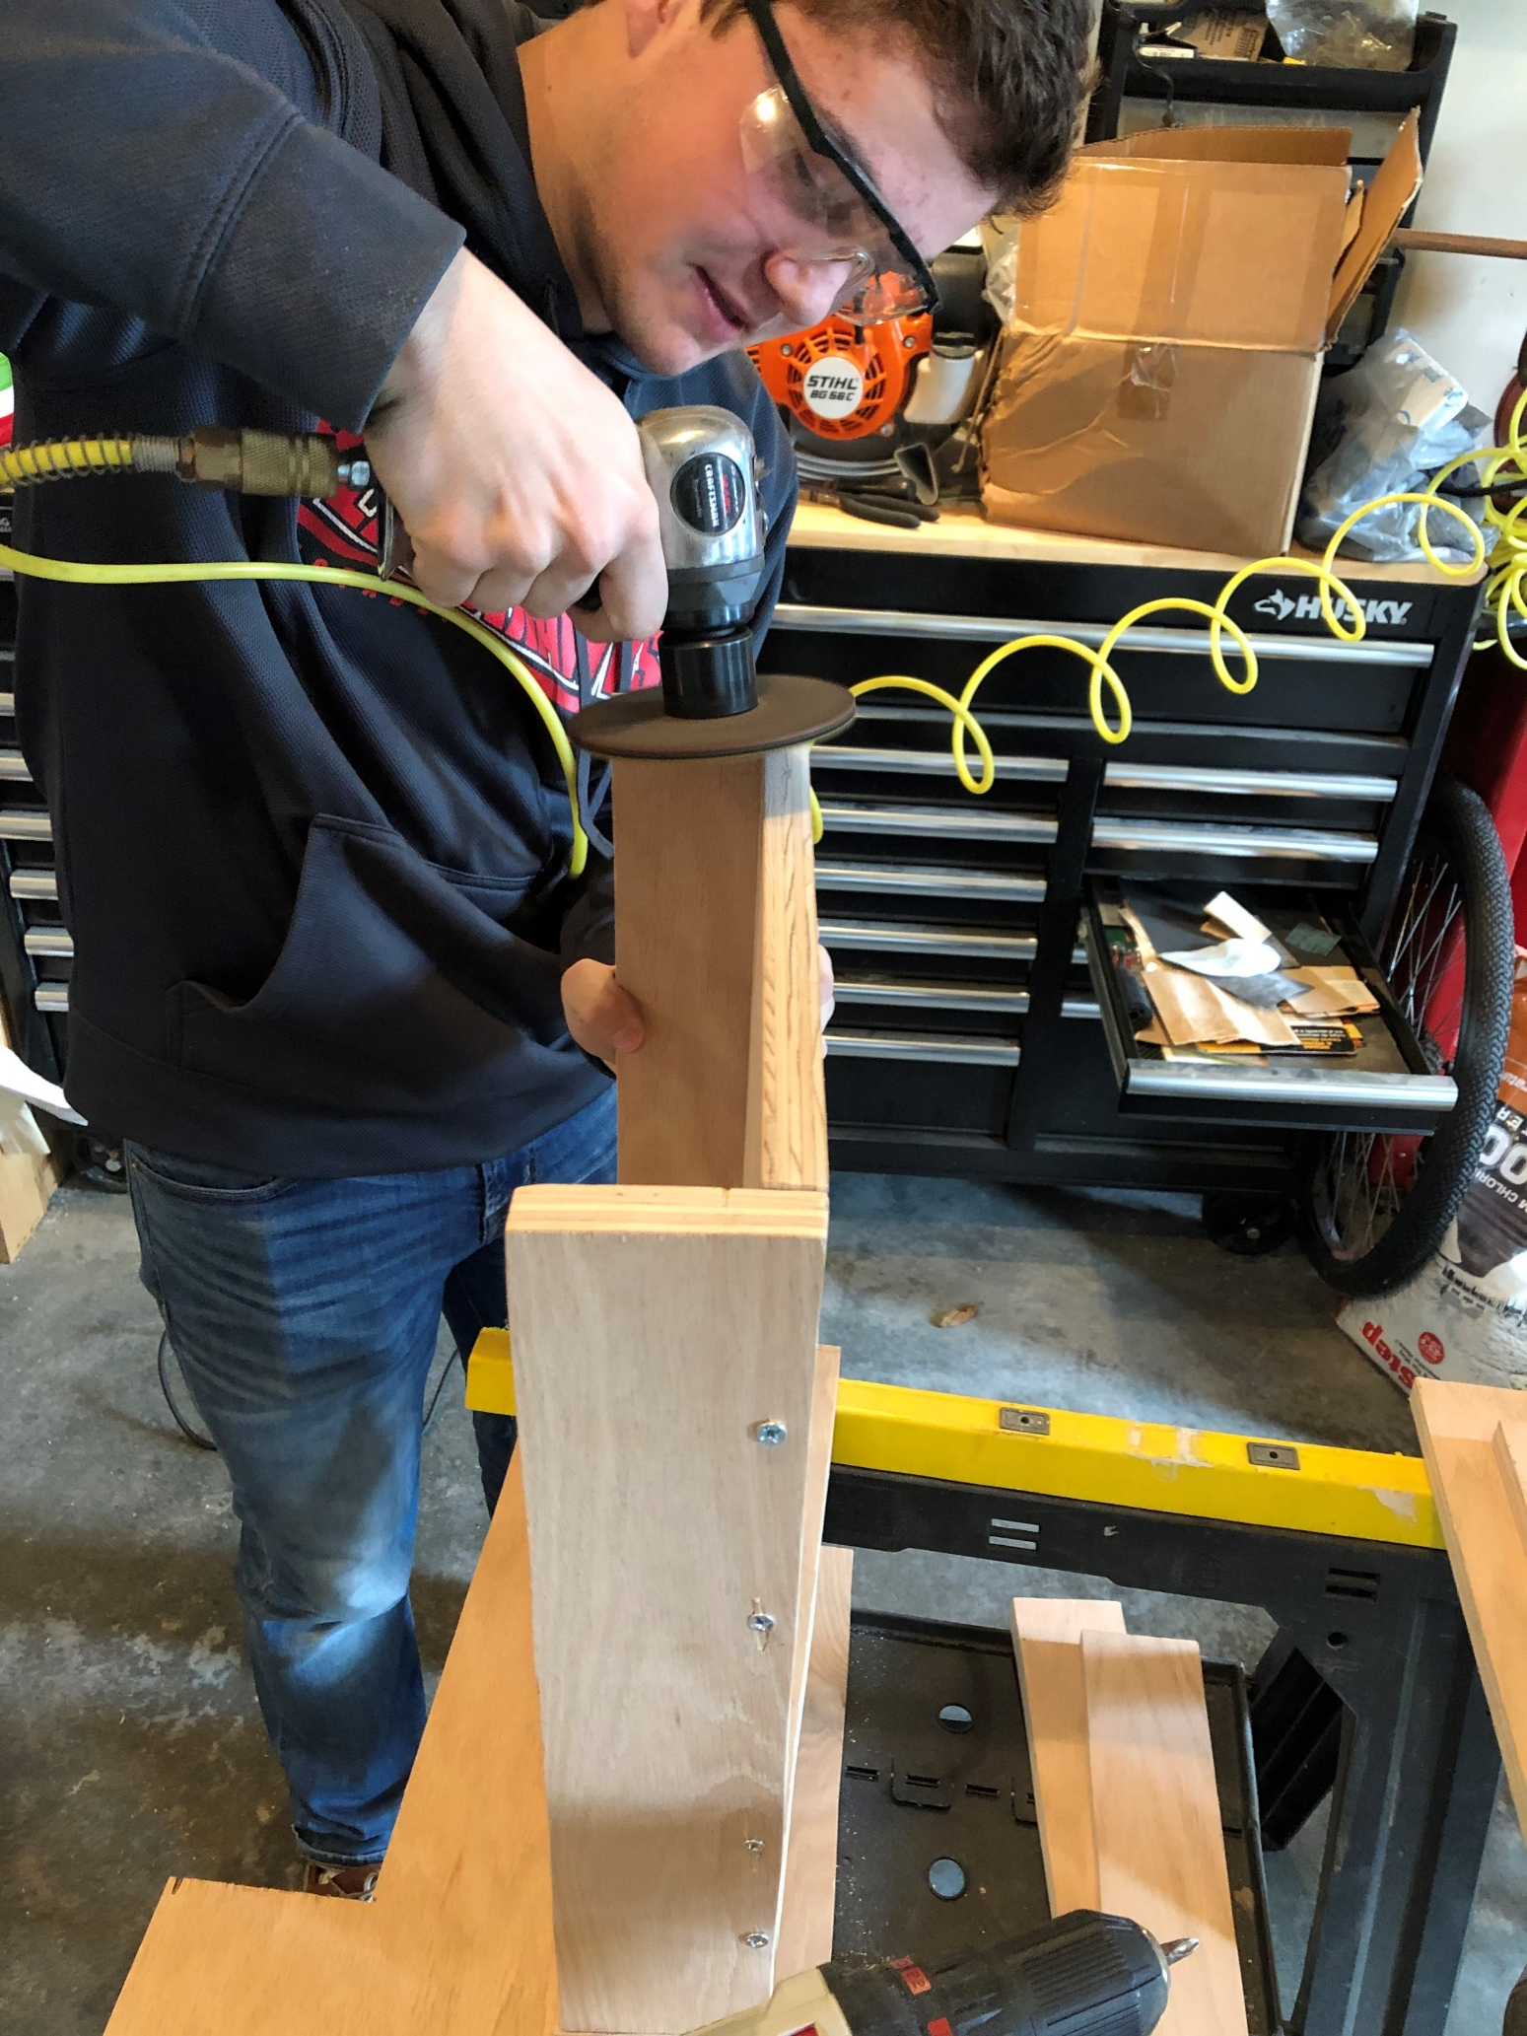
Step 2:
Sand all the wood to make sure there are no rough edges or sides

Slide 7
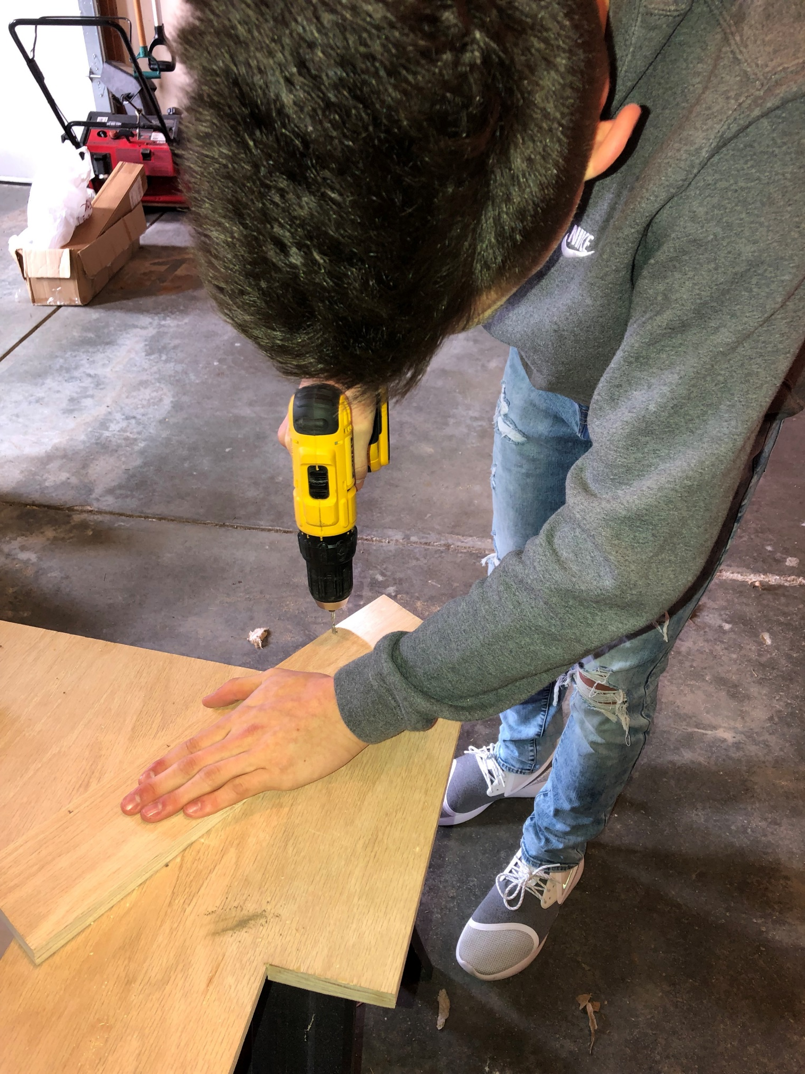
Step 3:
Pre-drilling holes for the screws to have something to grab onto.

Slide 8
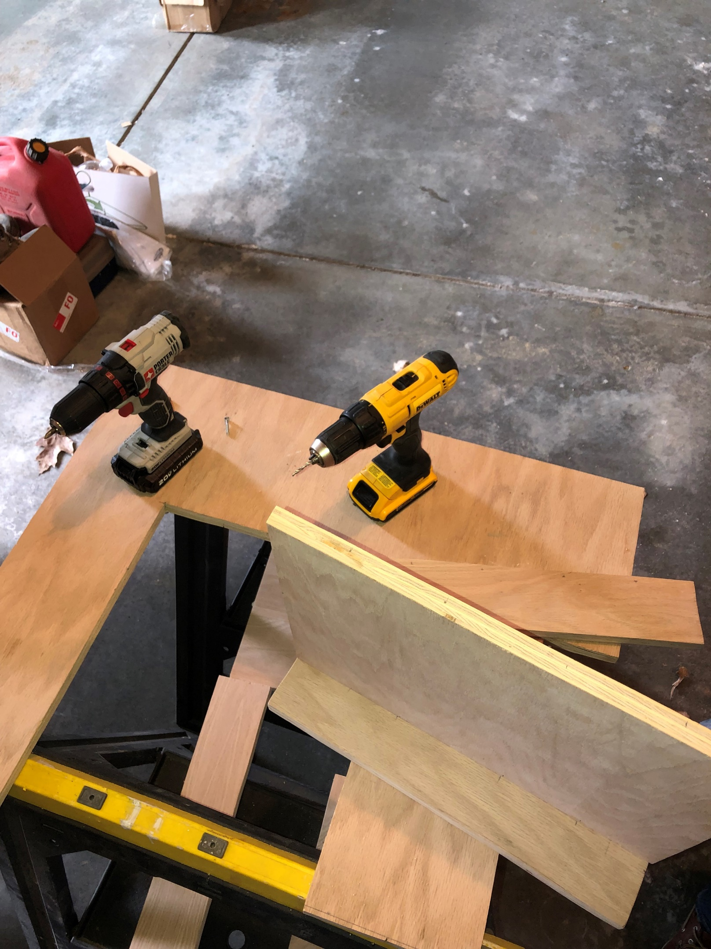
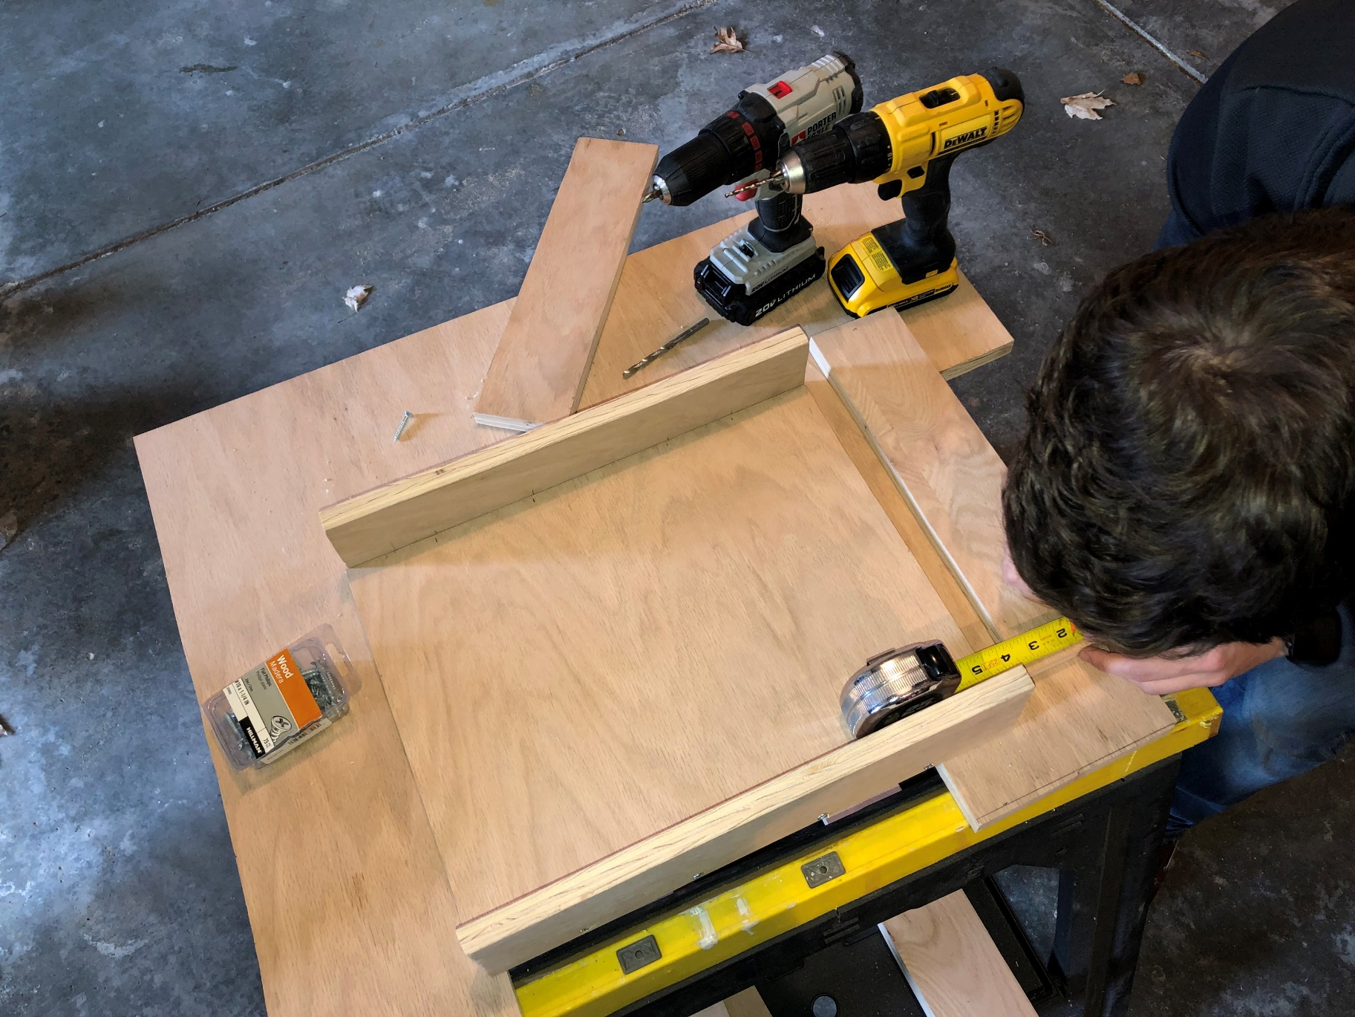
Step 4:
Screwing all the cut pieces together to form the hollowed out box.

Slide 9
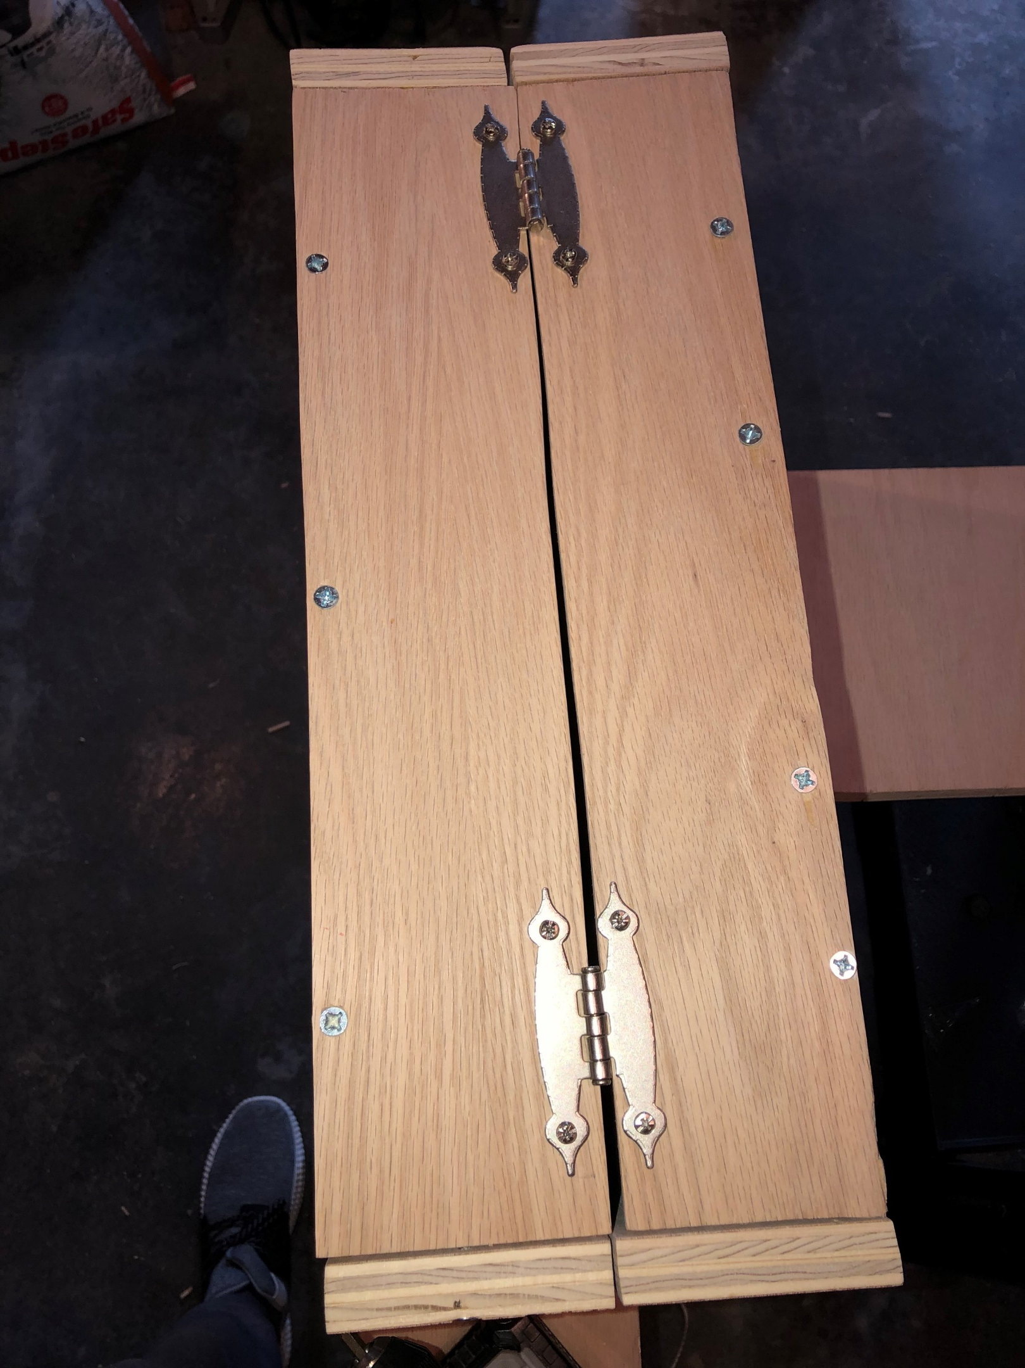
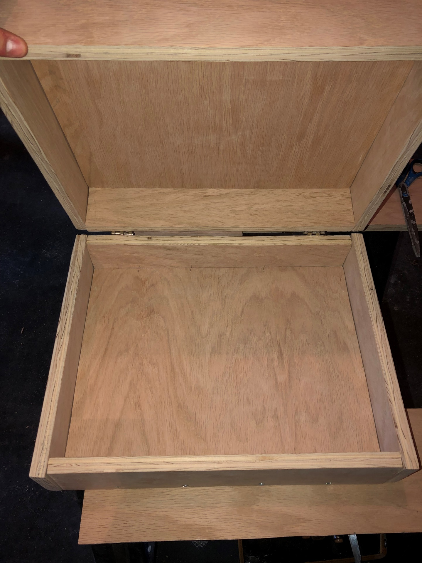
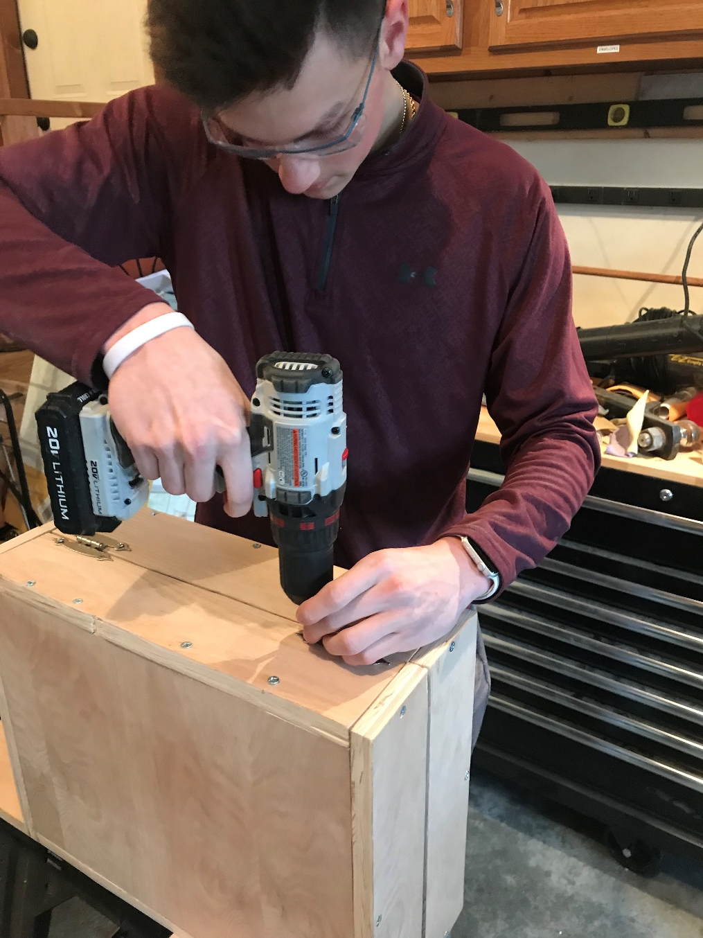
Step 5:
Putting on hinges so box can open and close easily

Slide 10
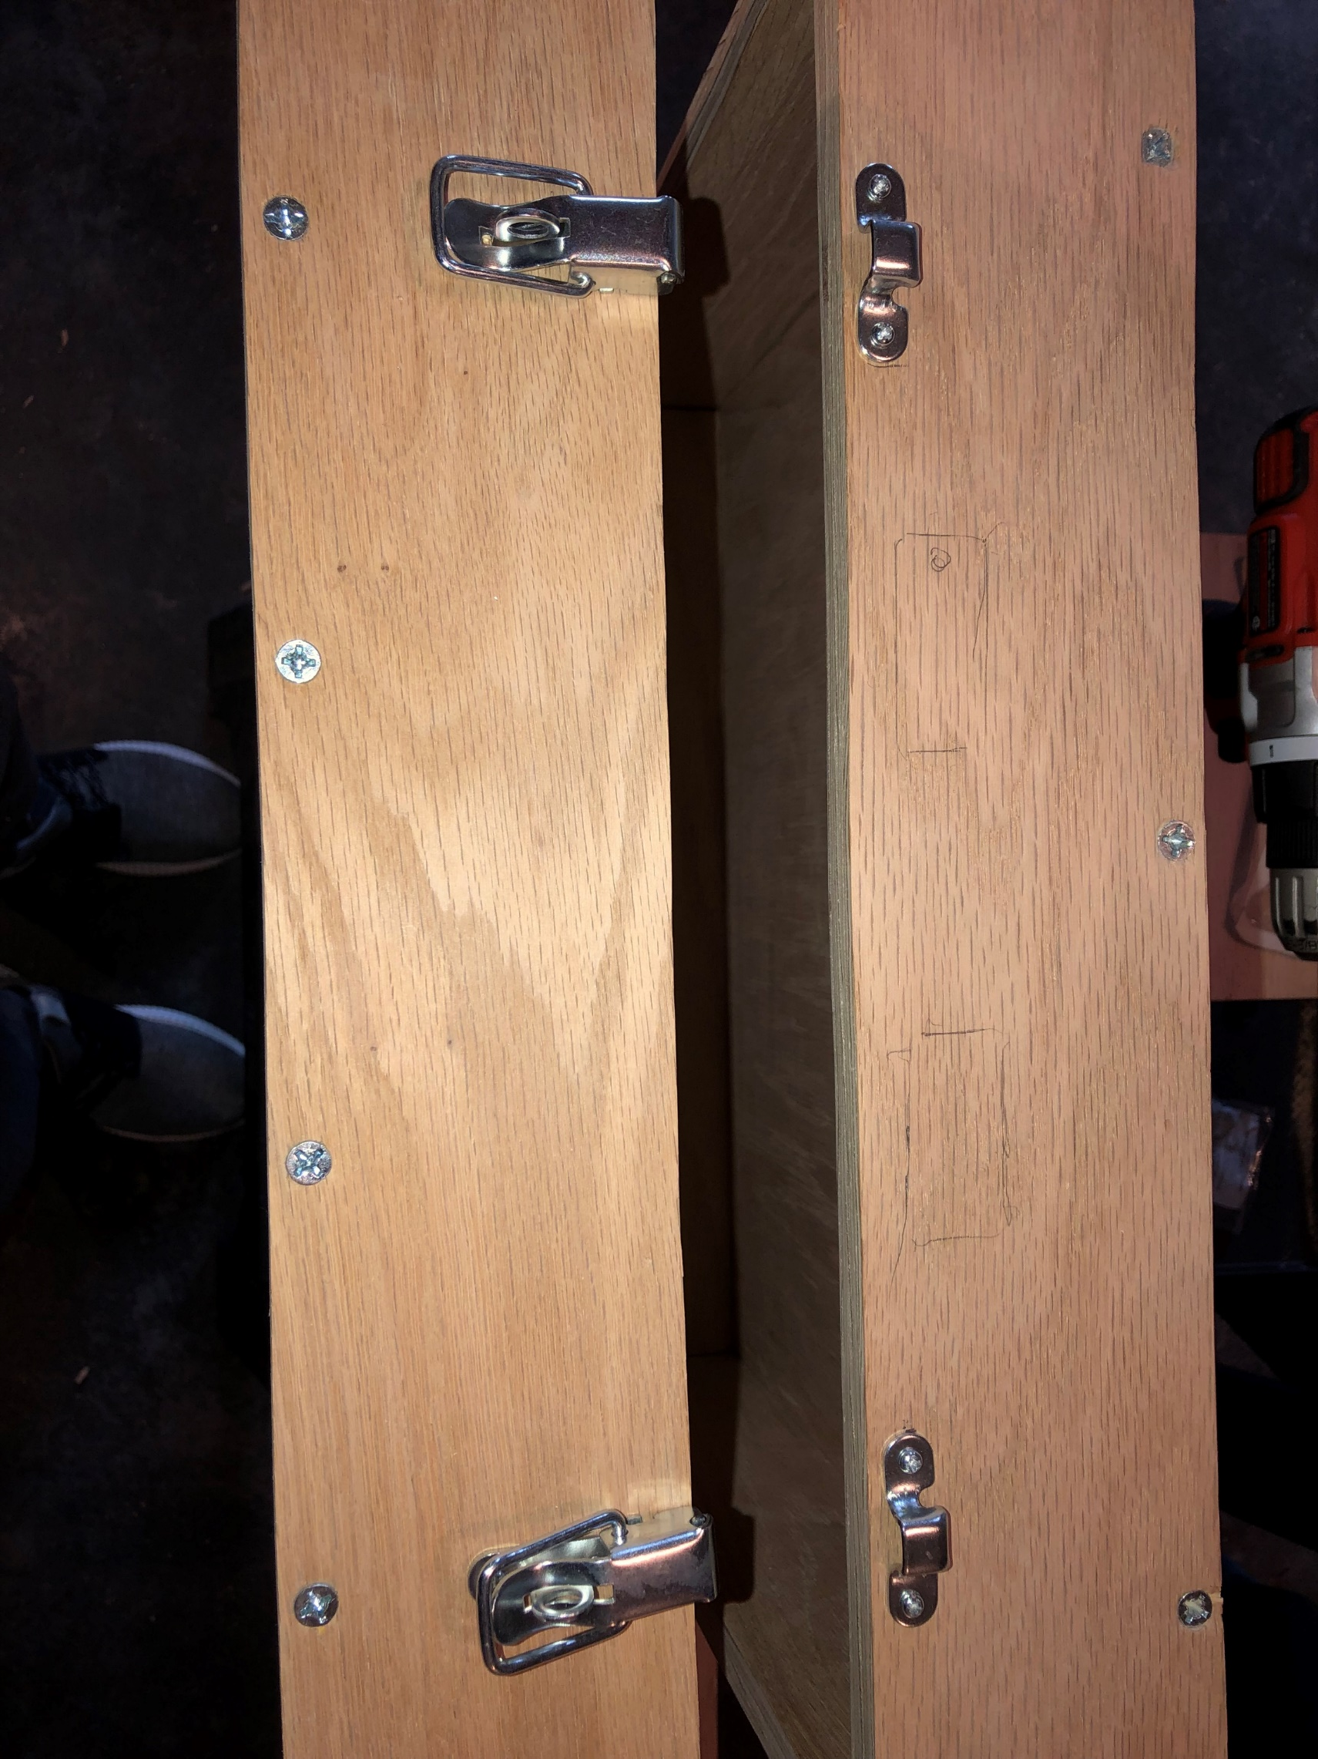
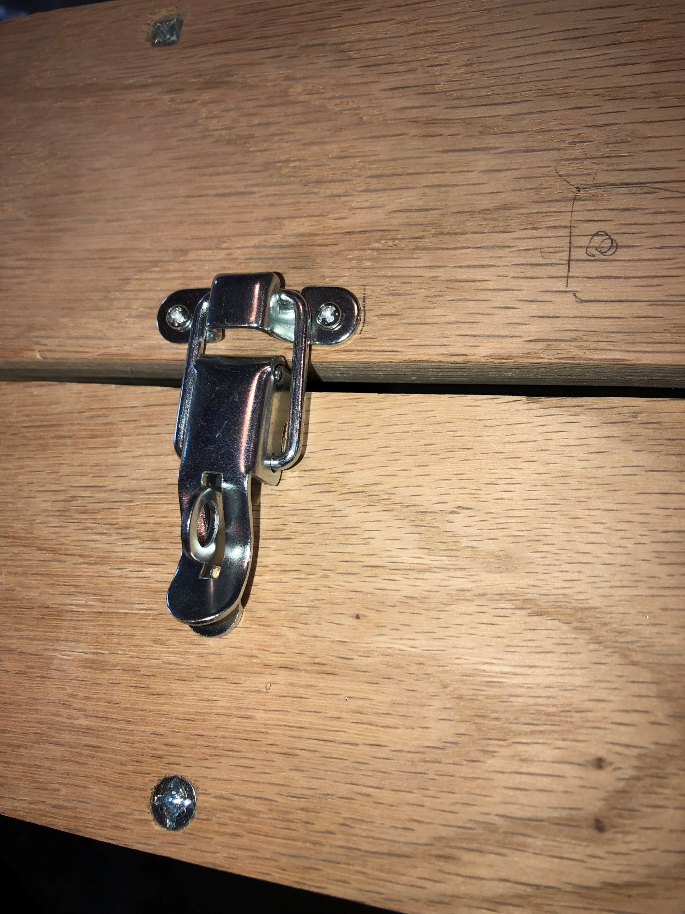
Step 6:
Attaching Latches so the Briefcase is secure and can stay closed

Slide 11
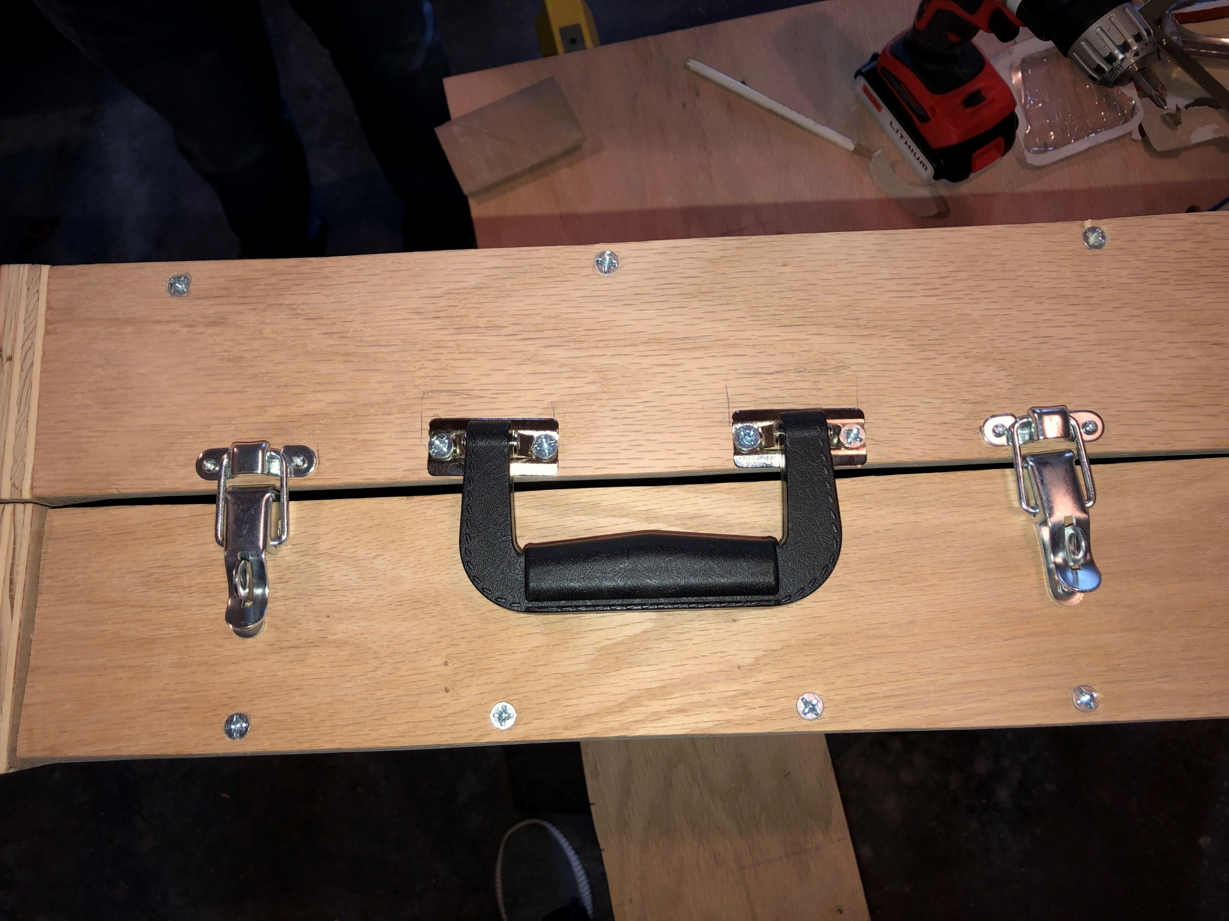
Step 7:
Attaching the handle so you can carry the briefcase on the go

Slide 12
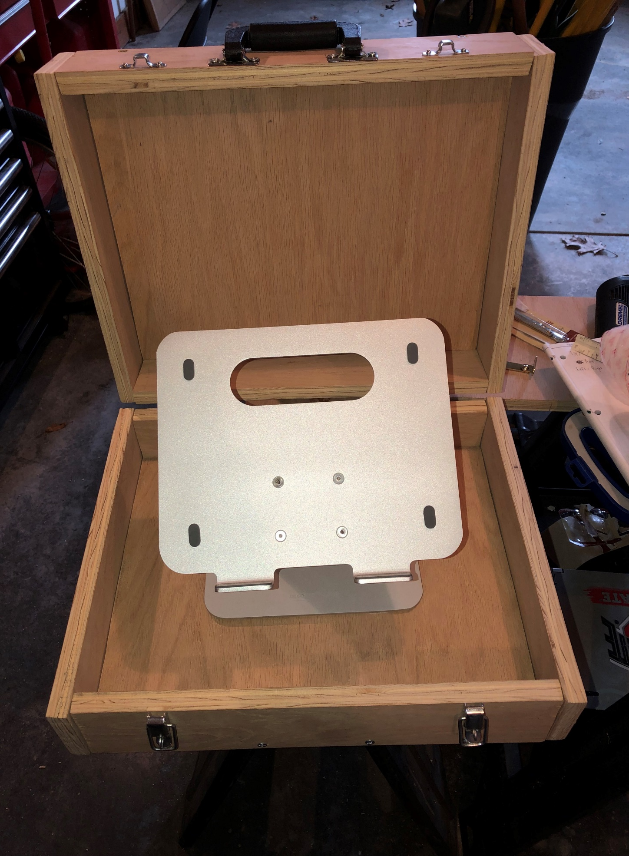
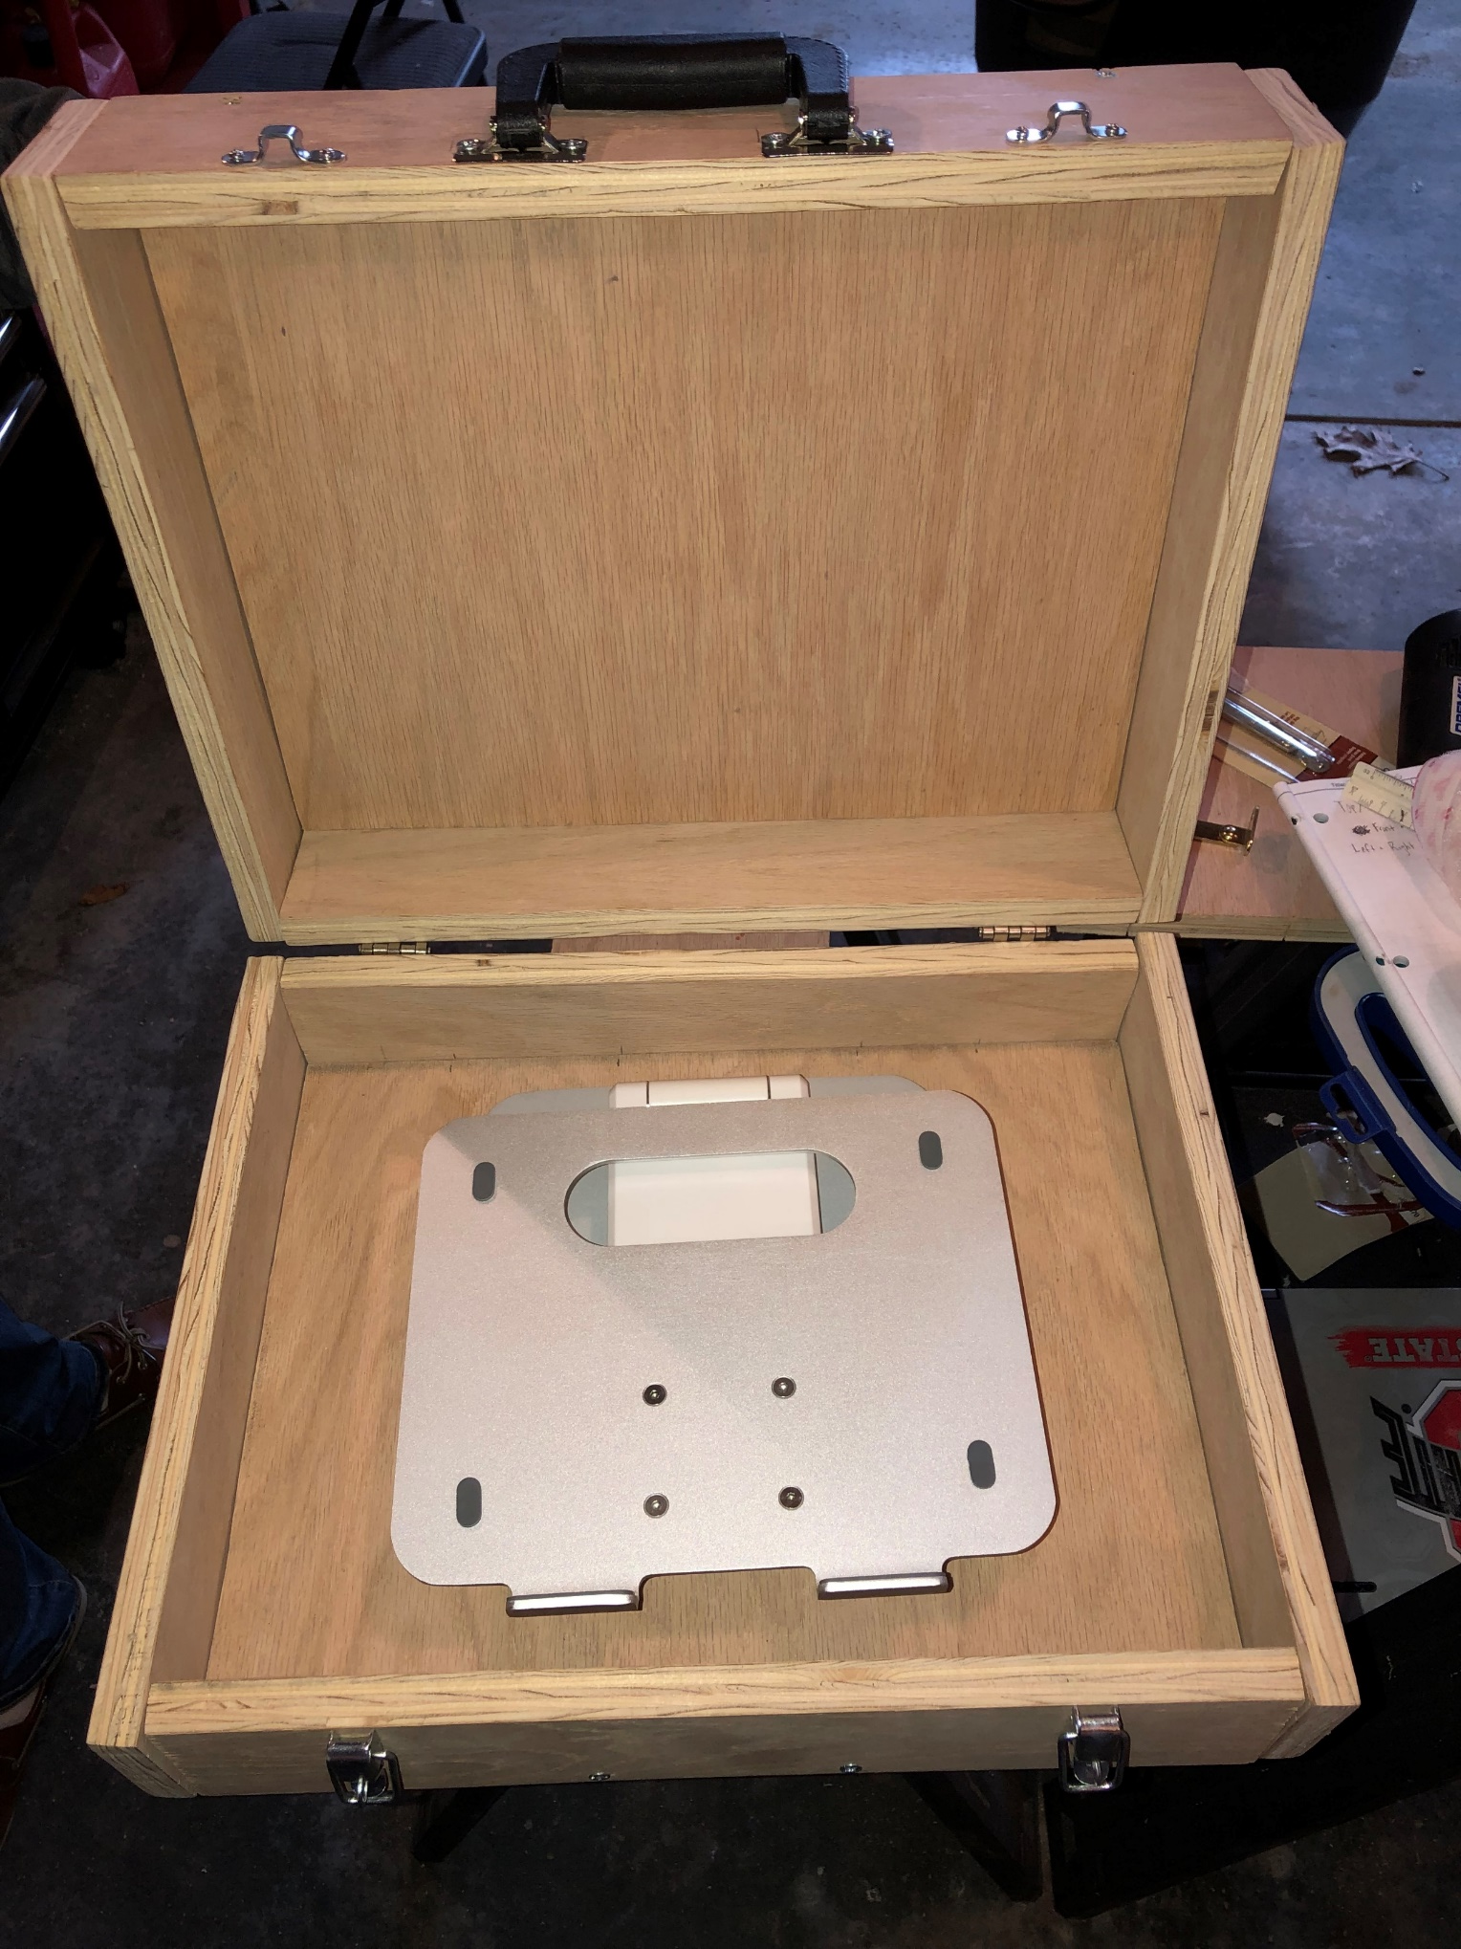
Step 8:
Attaching the computer stand to hold a computer

Slide 13
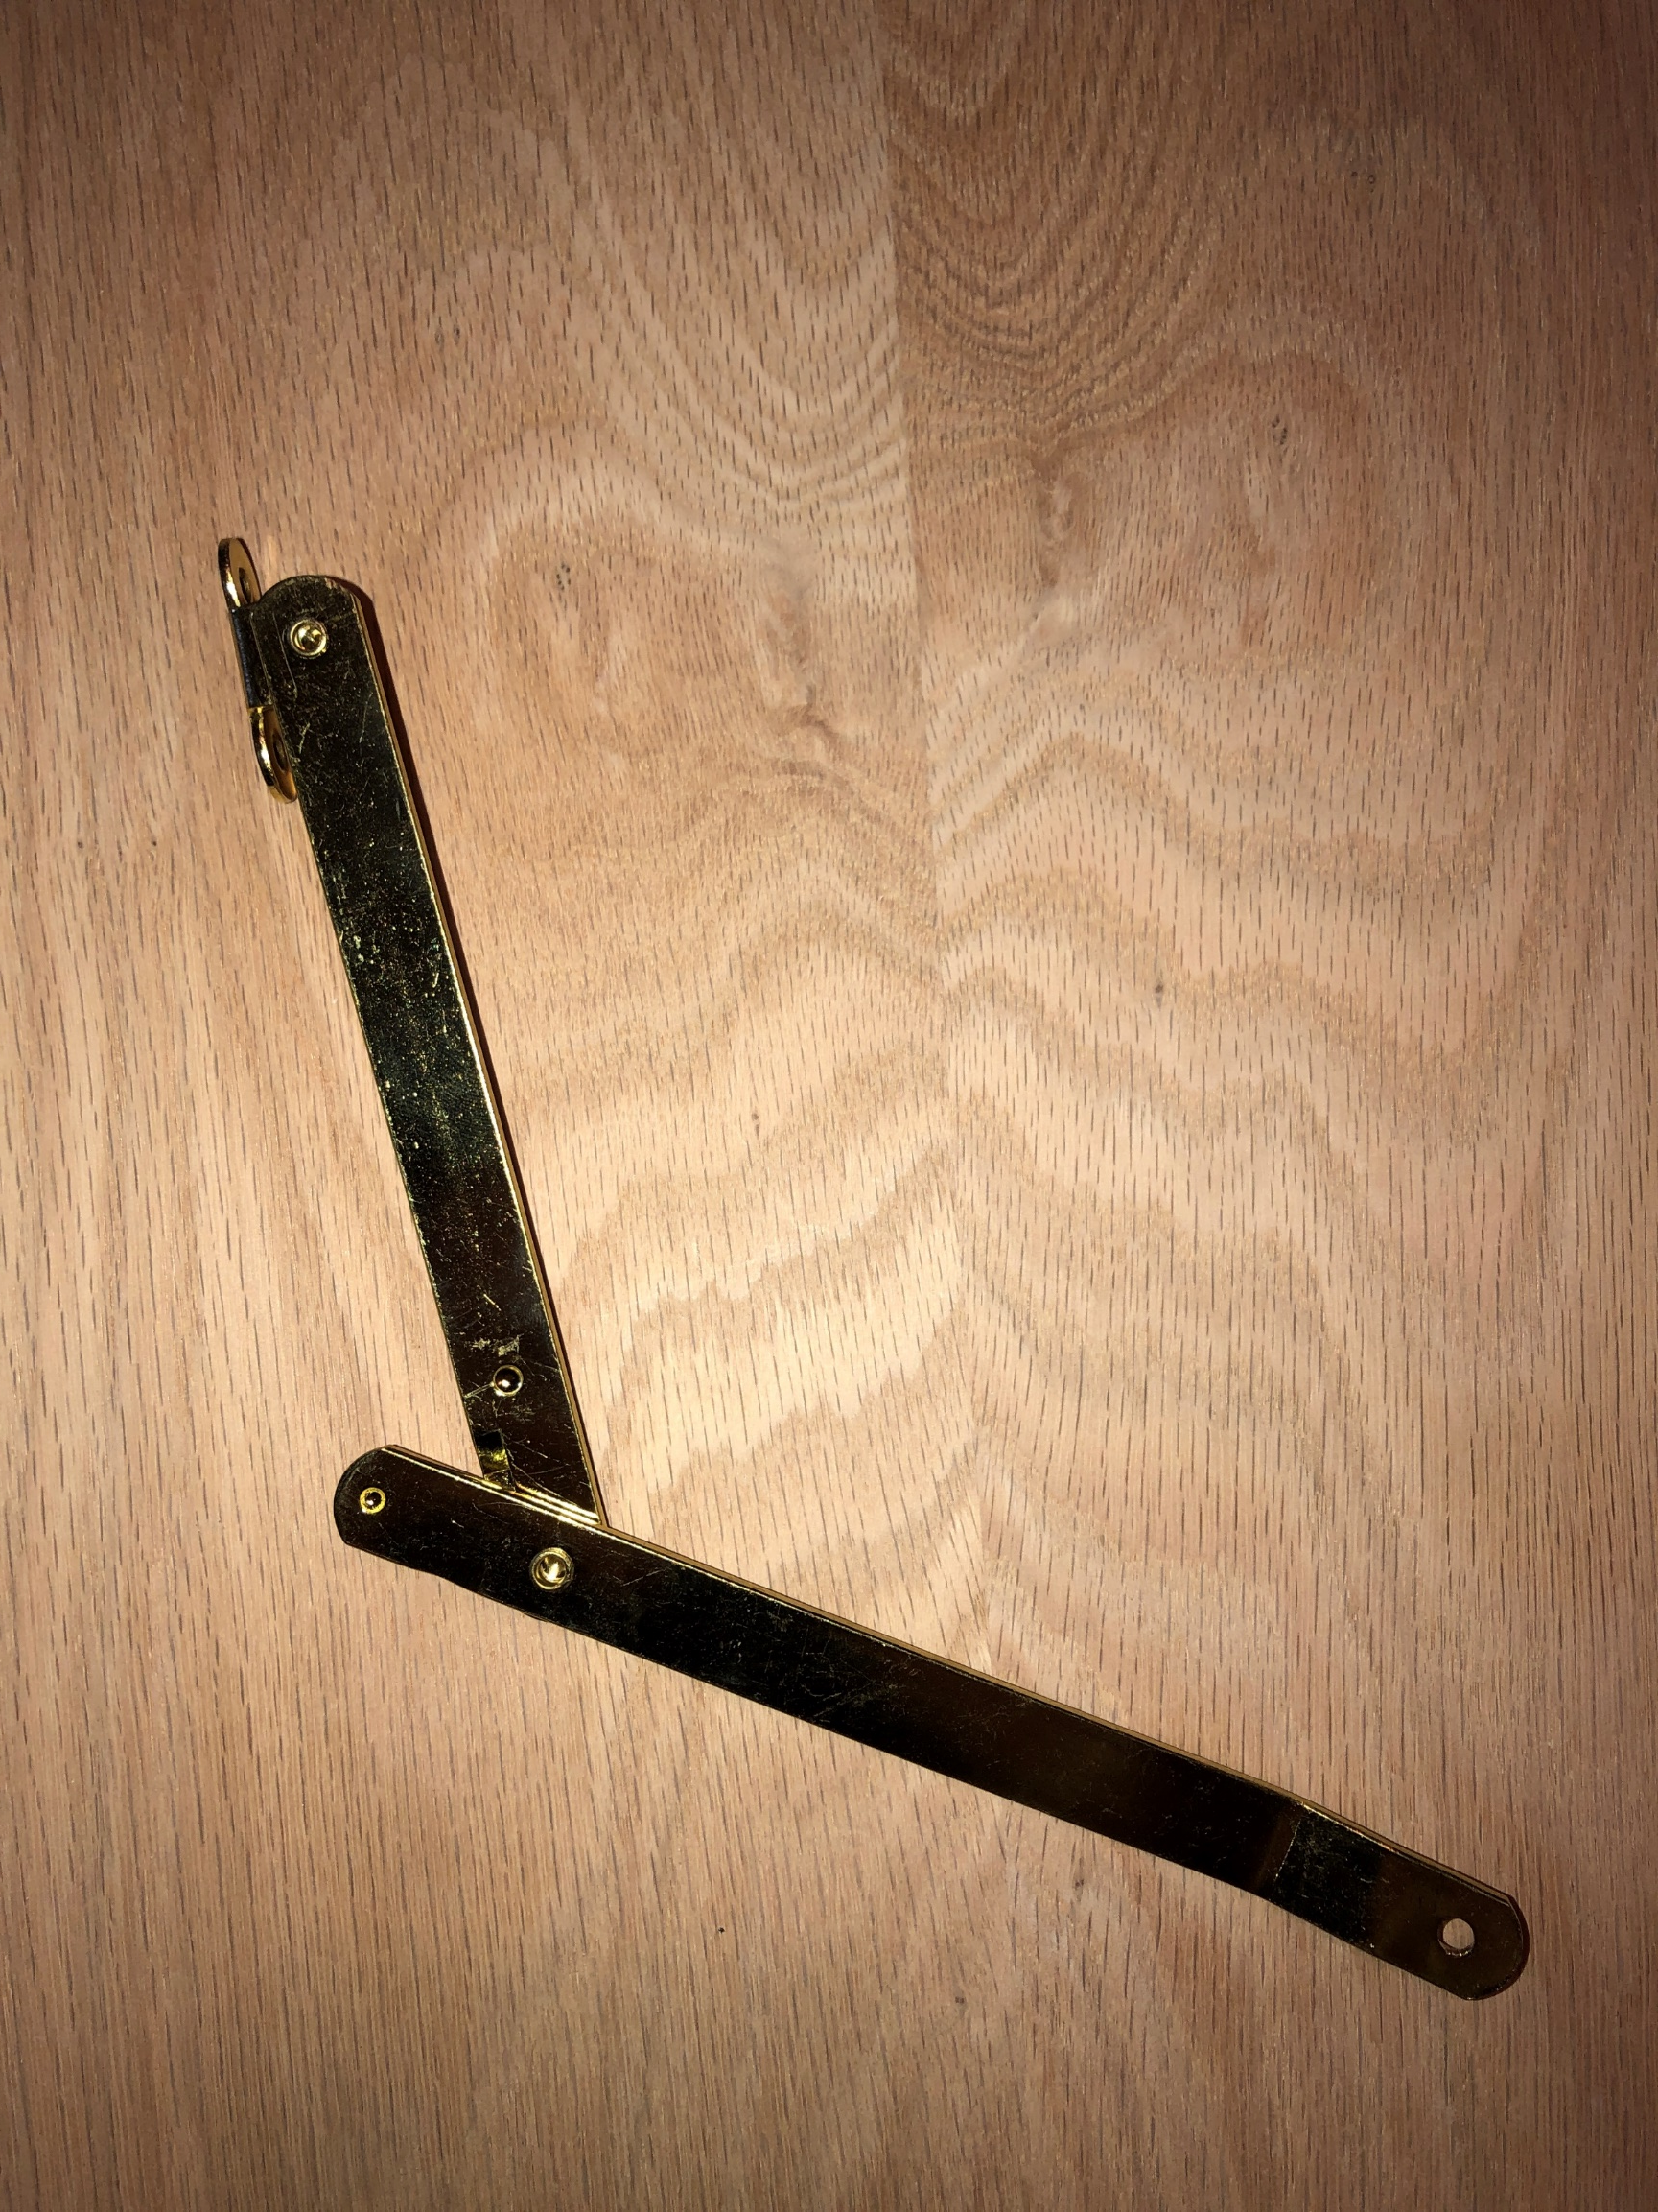
Step 9:
Place folding hinge to hold the top half of the Briefcase up on its own

Slide 14
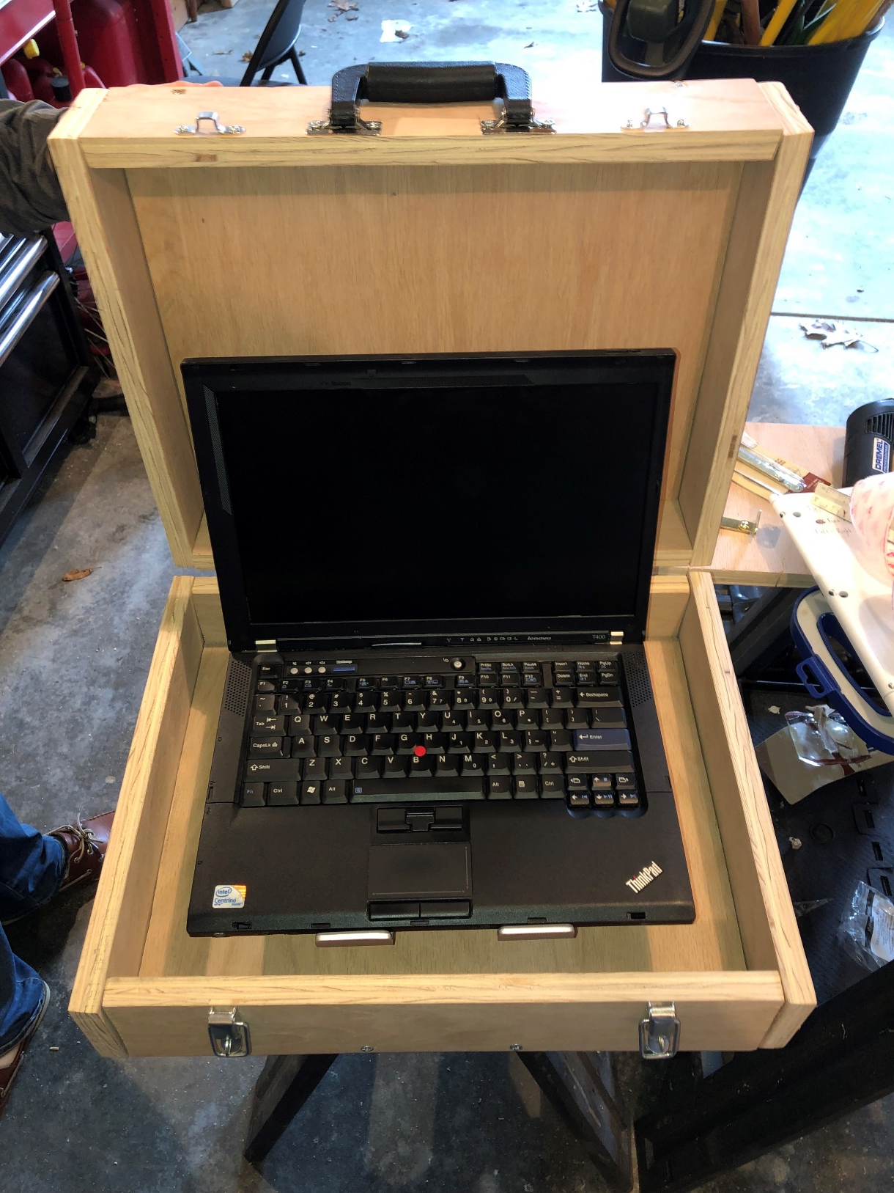
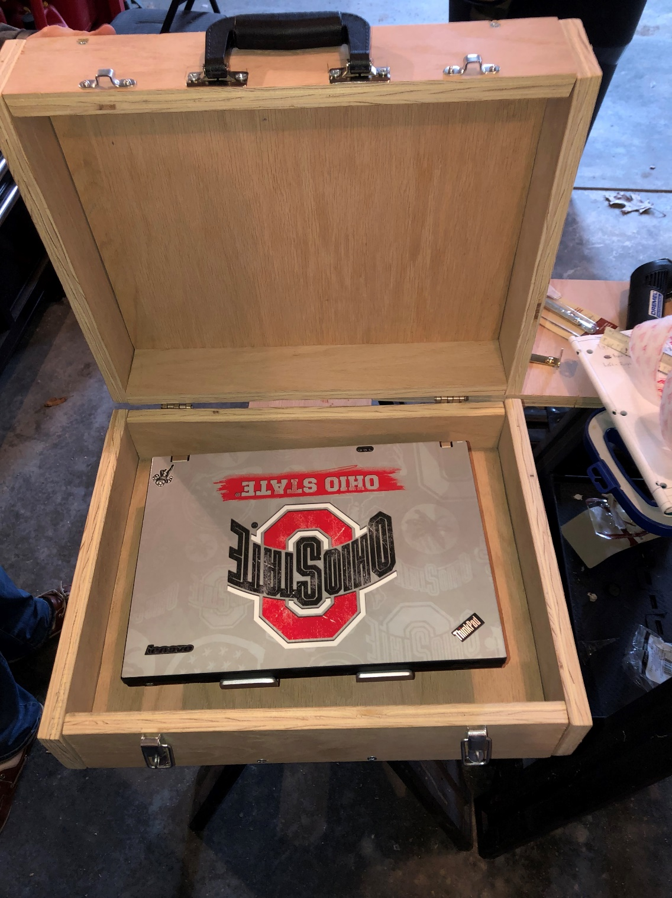
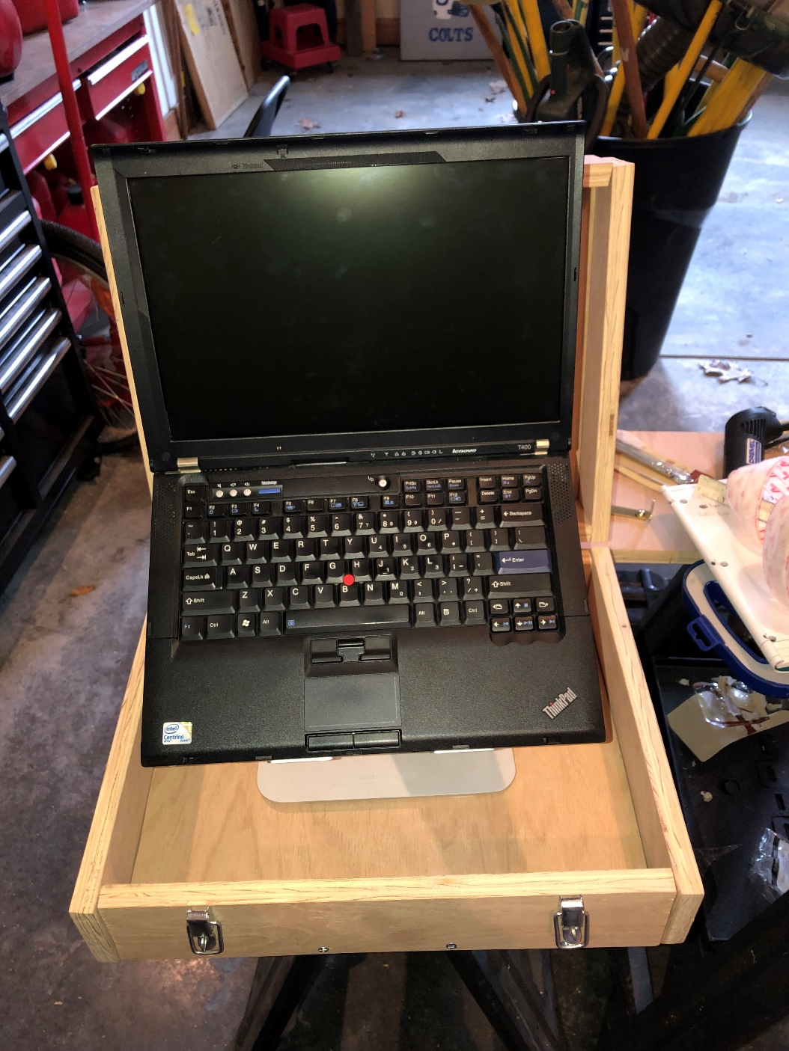
Step 10:
Place Laptop inside briefcase to test out computer stand

